Slide 1
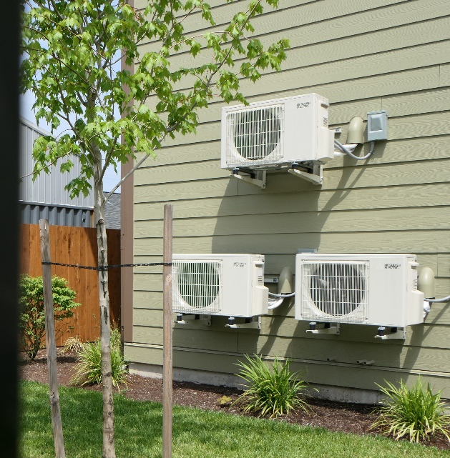
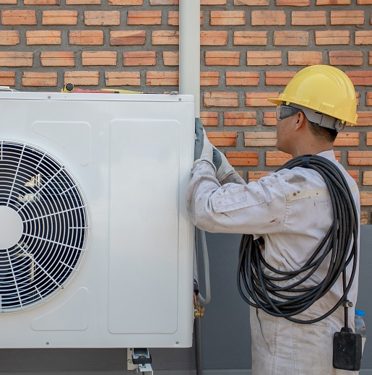
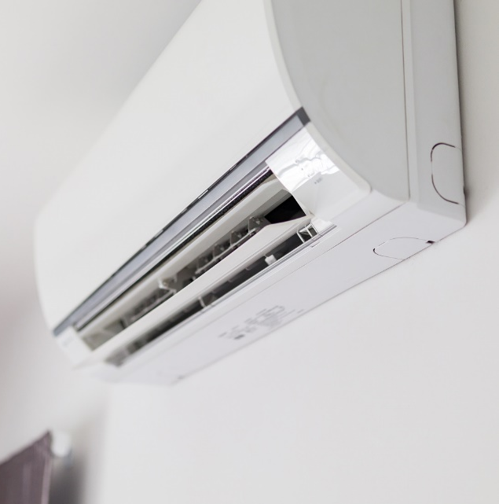

Oregon Department of ENERGY Response to Recent Extreme Heat in Oregon 2025 Extreme Heat Summit Stephanie Kruse

Slide 2

OREGON DEPARTMENT OF ENERGY
Leading Oregon to a safe, equitable, clean, and sustainable energy future.
The Oregon Department of Energy helps Oregonians make informed decisions and maintain a resilient and affordable energy system. We advance solutions to shape an equitable clean energy transition, protect the environment and public health, and responsibly balance energy needs and impacts for current and future generations.
Our Mission
On behalf of Oregonians across the state, the Oregon Department of Energy achieves its mission by providing:
​​A Central Repository of Energy Data, Information, and Analysis
A Venue for Problem-Solving Oregon's Energy Challenges
Energy Education and Technical Assistance
Regulation and Oversight
Energy Programs and Activities
What We Do
Notes:
Use this slide as necessary to remind folks who we are.

Slide 3







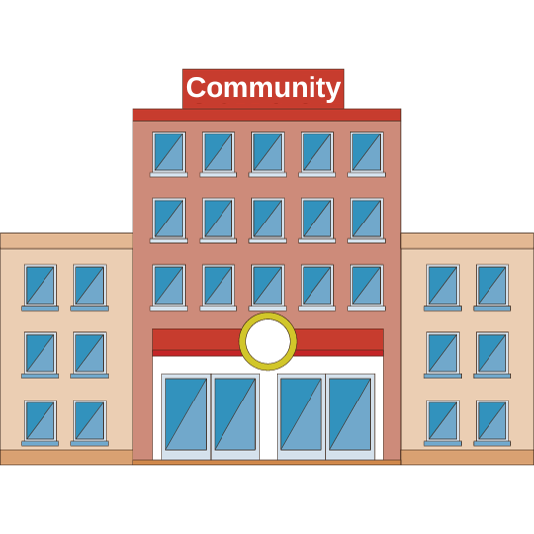

OREGON COOLING NEEDS STUDY
Directed ODOE to conduct a Cooling Needs Study
$10 M for a heat pump deployment program
$15 M in grants and rebates for landlords to install heat pumps
$2 M in grant funding for a community cooling center program
2022’s Senate Bill 1536 Aimed to improve indoor cooling and allocate cooling infrastructure funds.
Landlords may not* prohibit or restrict tenants from installing or using portable cooling device.
Created an Oregon Health Authority program to distribute air conditioners and air filters.
Non-legislative actions
Portland Emergency Heat Response Program
Multnomah County Heat Vulnerability Index
Mandated cooling systems in new residential units.
Updated language for “warming centers” to include cooling and air filtration.
Mandated cooling systems in at least one room for new residential units.
Notes:
* Indicates that there are some exceptions to this rule.

Slide 4
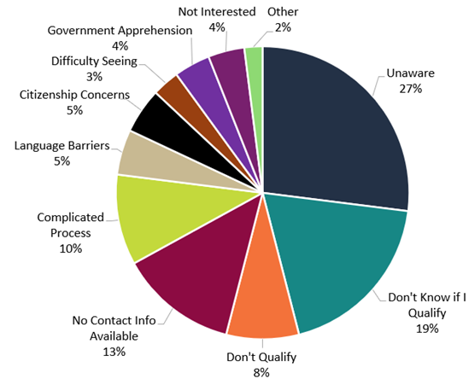
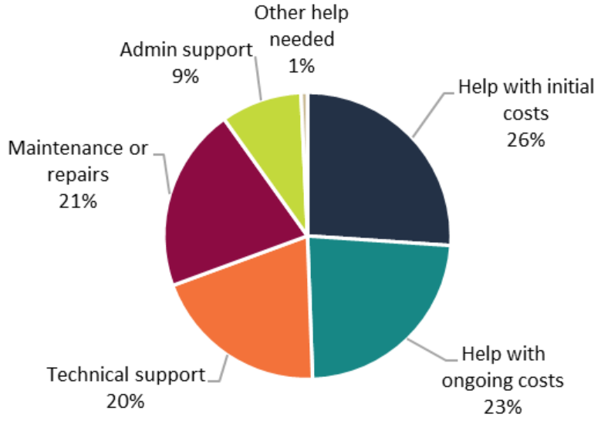
STUDY FINDINGS: SOCIAL BARRIERS
Types of support needed to upgrade cooling:
Reasons for not using assistance programs:

Slide 5
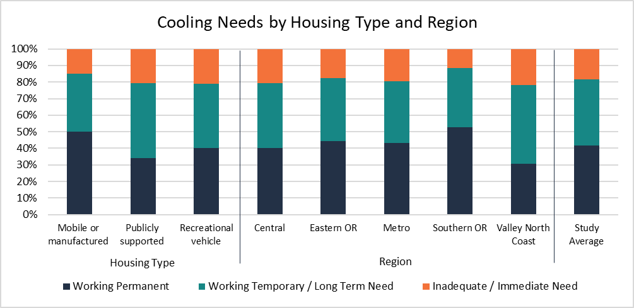
STUDY FINDINGS: REGIONAL NEEDS
Notes:
58% of survey respondents need permanent cooling. The total cost for installing the preferred cooling equipment across all housing types is estimated between $582.1 million and $1.05 billion.
Definitions of cooling types and quality of cooling for the purpose of this study: • Permanently installed equipment (permanent equipment): Central air conditioners, central heat pumps, ductless heat pumps • Temporarily installed equipment (temporary equipment): Window or wall air conditioners, portable air conditioners • Inadequate equipment: Swamp coolers, sunshades/sunscreens/blinds, electric fans, no cooling equipment Definitions of cooling needs for the purpose of this study: • Immediate need: Households that do not have cooling equipment or only have inadequate equipment have an immediate need for permanent (or temporary) cooling equipment • Long-term need: Households that only have temporary cooling equipment have a long-term need for permanent equipment

Slide 6
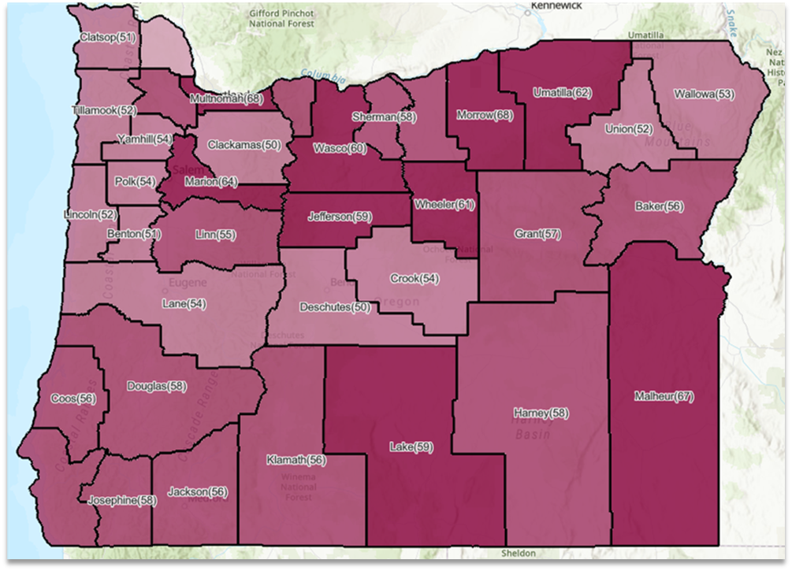
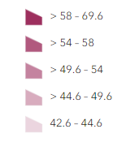
HEAT VULNERABILITY INDEX

Slide 7

What level programs should be implemented – don’t assume administrative capacity (for example in Tribes and community based organizations (CBOs), etc.)
10% administration budget is challenging, both for ODOE and for CBOs
Limits QA, outreach, etc.
Short term funding structure makes it difficult to administer as well (hiring single year temp positions)
Areas with local collaboration spaces were able to take best advantage of state programs
"health, life & safety" is not energy efficiency, though they can complement each other (different mission/business line)
Outreach, communications, and more outreach
Key Takeaways
from program implementation

Slide 8
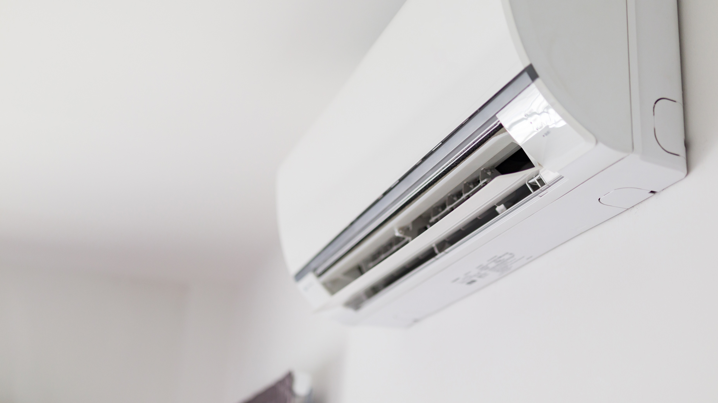

Contact Information
Stephanie Kruse
Stephanie.Kruse@energy.oregon.gov

