Slide 1
Indiana Energy Independence Fund
Residential and Commercial Clean Energy Financing

Slide 2



Contractor Account Manager
Executive Director
Chris Kerlin
ckerlin@EnergyIndependenceFund.org
317-449-4124
Alex Crowley
acrowley@EnergyIndependenceFund.org
812-360-5566

Slide 3
The Indiana Energy Independence Fund (IEIF) is the state’s nonprofit green bank offering Indiana businesses, nonprofit organizations, government facilities, other public institutions and homeowners lower than market rate financing solutions for energy efficiency, renewable energy and resiliency projects.

Slide 4
What is a “green bank”?
Facilitates private investment into domestic low-carbon, climate-resilient infrastructure
Focuses on renewable energy, energy efficiency, and alternative fuel vehicles and infrastructure
Supports single-family and multi-family residential, commercial, industrial, non-profit, government sectors
A public, quasi-public, or non-profit entity (typically not a regulated depository institution)
There are 50+ green banks in the US

Slide 5
Why the Indiana Energy Independence Fund (IEIF) was created:
Created to fill void of clean energy financing in Indiana
Supported by local philanthropy
Supported by other green banks: MI Saves
Established national partners for our loan programs
Inclusive Prosperity Capital (IPC) – Smart e Residential loans
National Energy Improvement Fund (NEIF) – Commercial loans

Slide 6
Residential Financing

Slide 7
IEIF Smart-E Residential Financing Program
Smart-E Loan - Basic Terms
Rate | 6.99%-7.99%*
Repayment | 5, 7, 10, 12, 15 and 20 year terms available
Amount | $500 minimum - $50,000 maximum. Covers 100% of eligible project costs, no money down
Eligible Borrowers | Owner occupied, 1-4 unit homes
*Rates as of 2/14/2025. Subject to change without notice
Program shown does not demonstrate all options or structures. Rates, terms, program, and underwriting policies mentioned in this presentation are subject to change without notice. The actual terms and rates applicable to any product or service may vary based on market conditions and other factors.
Notes:
Chris

Slide 8
What Residential Improvements Qualify?
High-efficiency HVAC
Heat Pumps
Furnaces
Duct Sealing and Insulation
Smart thermostats
Envelope Improvements
Window and Exterior doors
Insulation and Insulated Siding
Renewable Energy
Solar and battery storage
Geothermal
Water Heating
High-Efficiency Water Heaters:
    Gas/Propane/Electric
Energy STAR® Appliance (limited to 25% financing)
Refrigerator
Washers
Heat pump dryers
Freezers
Lighting and electrical
Electrical system upgrades
EV Charging
Lighting and controls
Health and safety
Asbestos abatements (when coupled with HVAC)
Mold and Mildew removal and Radon abatement (when coupled with envelope improvements)
Notes:
Chris

Slide 9
What Residential Improvements Qualify?
Other possible measures (limited to 25% financing)
Tree removal
Home generators
Low Flow Fixtures
Unlisted measures that are relevant to improving energy efficiency
*Proposed measures are subject to review and approval for program eligibility by the Indiana Energy Independence Fund
For a Full Detailed List of Eligible Measures Go to the IEIF Website:
IEIF-Eligible Residential Measures
Notes:
Chris

Slide 10


Indiana Lender Details: Residential
Up to $50,000
580 FICO minimum
50% DTI maximum
DTI waived for 680+ FICO
Direct payment to contractor
Notes:
Chris (need Midwest logo – method of payment)

Slide 11
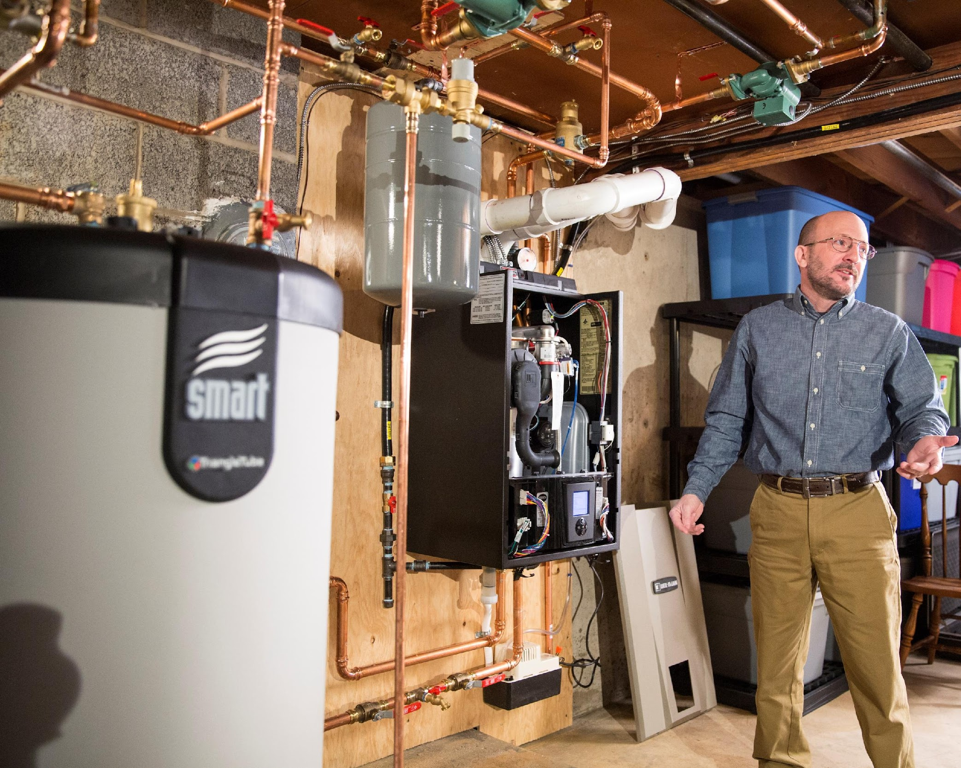
Cost to Participate: Residential
One-time setup fee: $50*
Origination fee per closed loan: 2.49%*
*subject to change
Apply to become an approved
residential contractor
Get started: https://indiana.ngenfinance.org/registration/profile

Slide 12
Commercial Financing

Slide 13

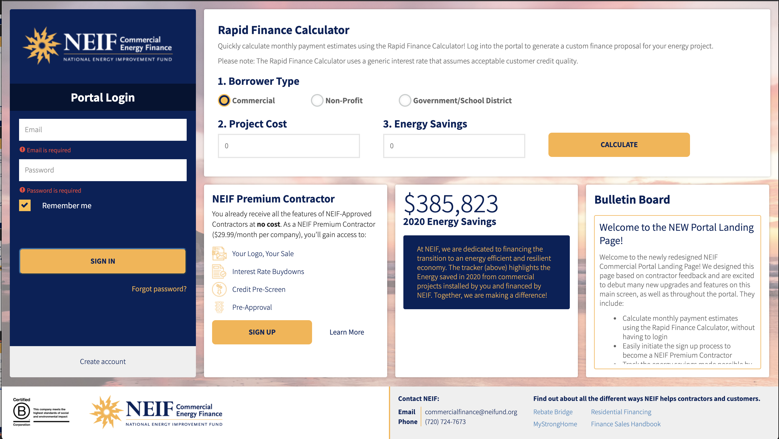
IEIF Commercial Financing Program
Basic Terms
Rate | 5.99%
Repayment | 1 – 10-year terms available
Amount | $2,000 minimum $150,000 maximum at 5.99%, projects above max can be financed at a below market interest rate
Eligible Borrowers | Any commercial business, non-profit, multifamily, or government property in Indiana
Online Financing
Sales Support
NEIF’s easy-to-use financing tools deliver simple, transparent, and fast financing options, on-demand reporting, and more.
IEIF & NEIF provides expert sales support to close deals. We ensure the finance process runs quickly, efficiently, and effectively.

Slide 14
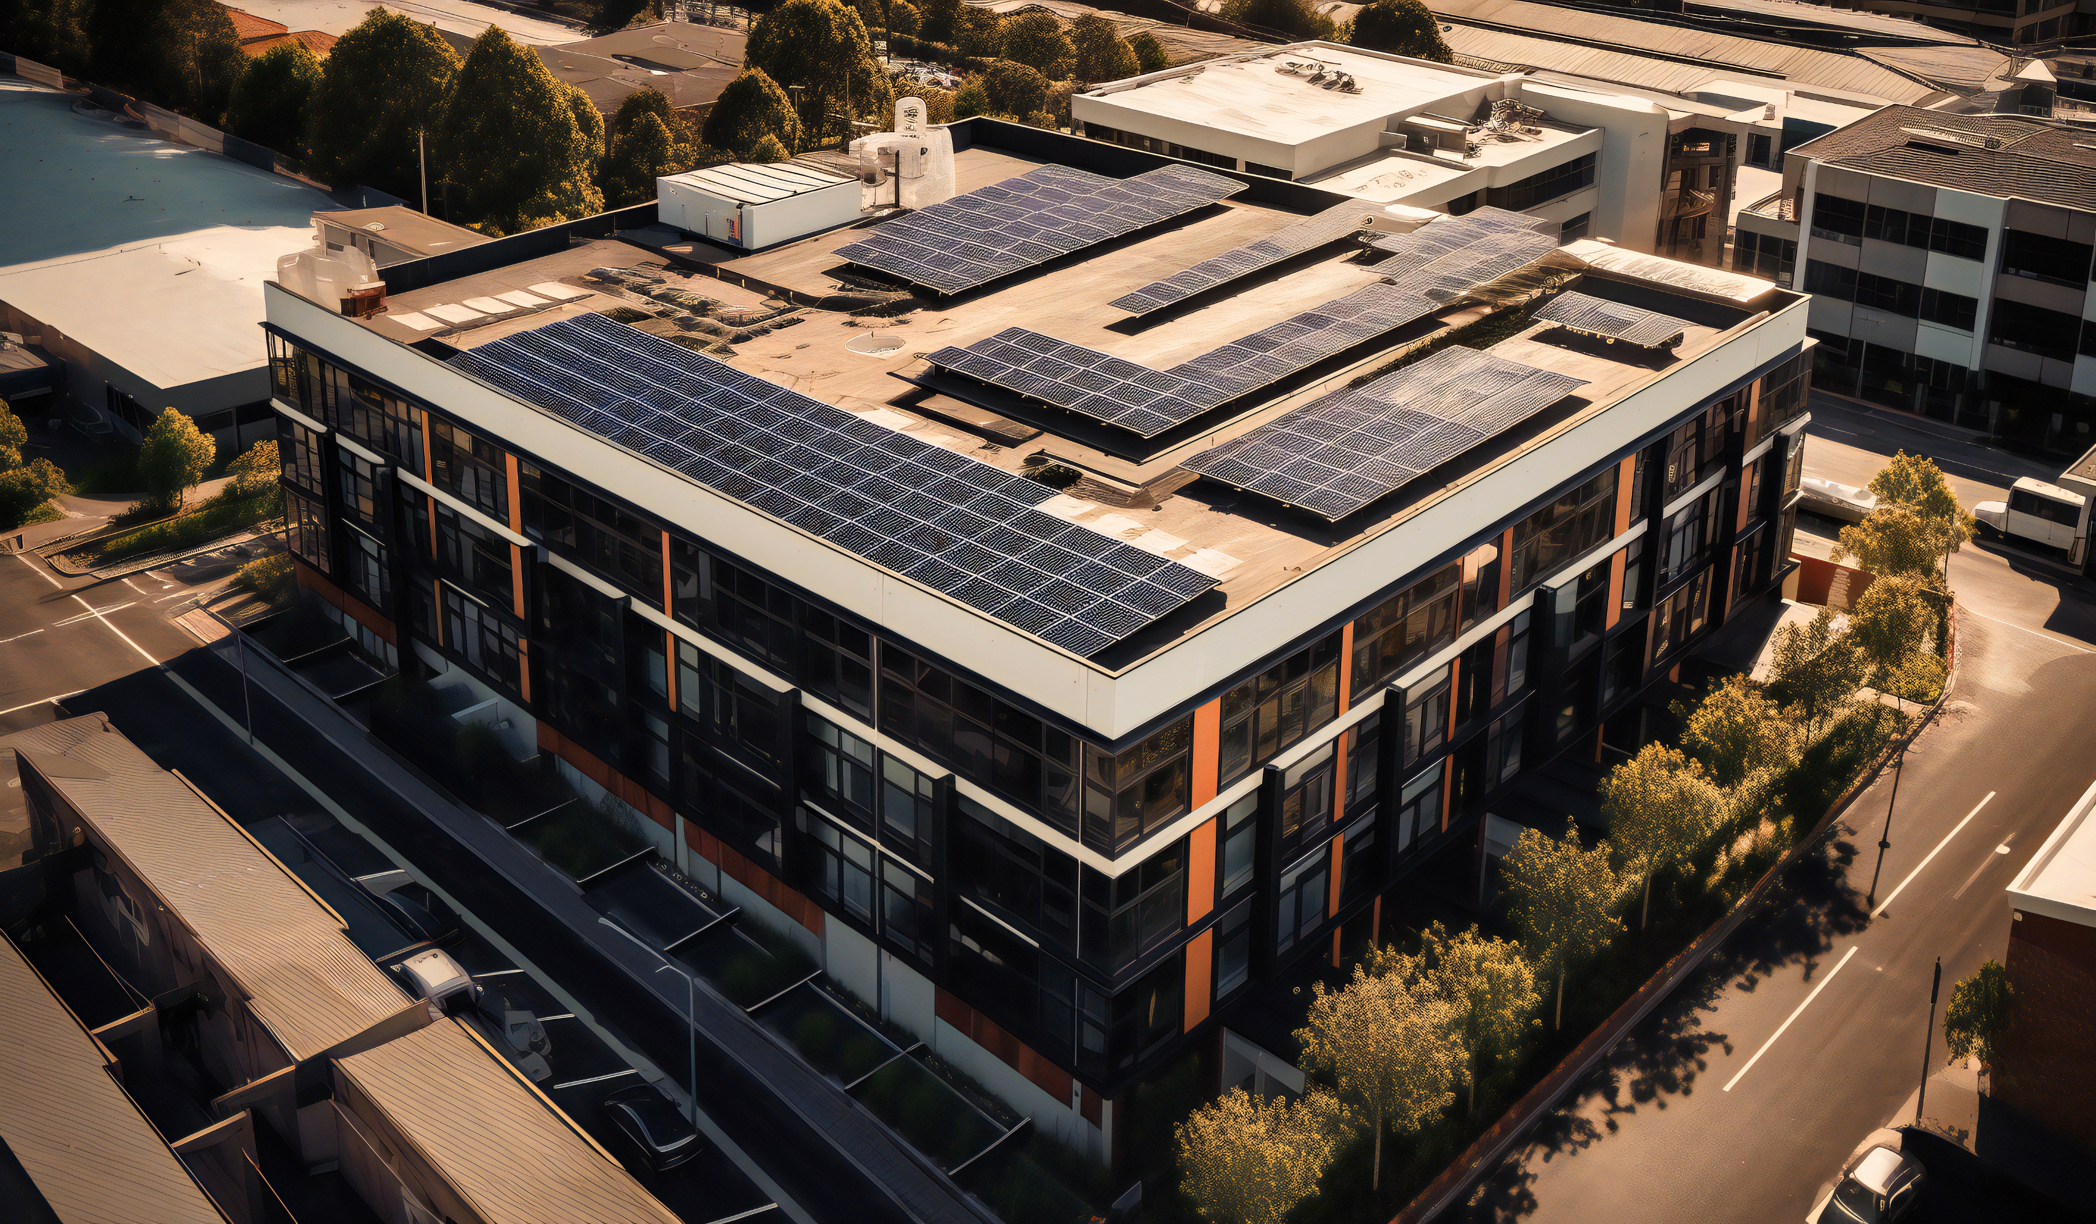
What Commercial Improvements Qualify?
LED Lighting & Electrical
High Efficiency HVAC
Refrigeration
Controls
Renewable Energy (e.g. Solar, Wind, Geo, Storage)
Water Saving Measures
Building Envelope
Retro-Commissioning
Other
Proposed and installed measures are subject to review and approval by the Indiana Energy Independence Fund for program eligibility. See a complete list of eligible measures here.

Slide 15
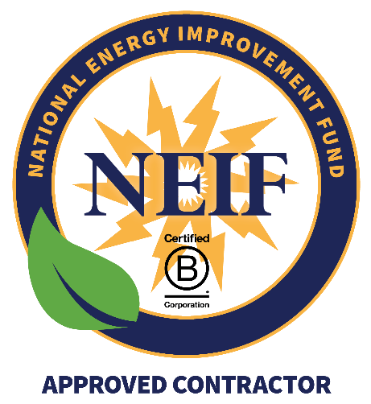
Working With IEIF and NEIF: Getting Started
Contractors: Register as an NEIF-Approved Contractor.
NEIF/IEIF-Approved Contractor Standards
There is no charge to become NEIF-Approved.
Minimum 3 years in business, history of financing stability and your certification of a minimum $50,000 company net worth or compensating factors.
Satisfactory company, Better Business and personal credit (if required) histories
Overall reputation for a high level of service and workmanship
Get Started At:
https://www.neifund.org/become-approved-contractor

