Slide 1
Built to Last: Delivering safe, healthy and affordable low-income housing
August 2025

Slide 2

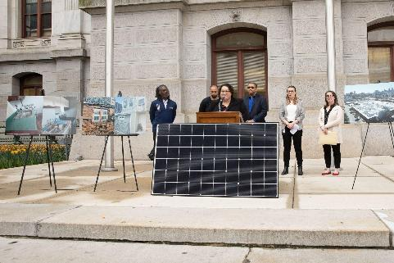
About the Philadelphia Energy Authority
Building a robust, equitable clean energy economy in Philadelphia
that helps address our biggest challenges
We support municipal, institutional and school district clean energy and capital programs
We develop and lead consumer programs to ensure all Philadelphians can benefit from the clean energy transition
We provide tools and programs to the commercial and industrial sectors to reduce energy costs and impact
We build the market by ensuring a well-trained, highly skilled, diverse workforce, ensuring access to capital through our affiliate, Philadelphia Green Capital Corp., and create a robust project pipeline that attracts new companies to Philadelphia and supports the growth of existing companies

Slide 3
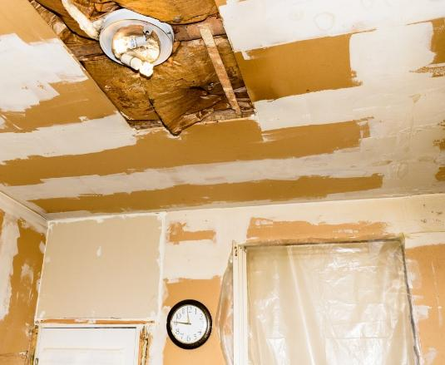
Philadelphia’s Energy Issues
Old housing stock and infrastructure
Historically high low-income home ownership, generations of deferred maintenance
Among the most energy burdened and energy insecure cities in the US
Top 10 highest rates of asthma and other chronic environmental justice issues
Existing home repair programs focused on emergency repairs and preventing displacement through defined and specific scopes of work, leaving gaps
Lack of coordination between program ecosystem creates administrative burden and deferrals for homeowners
A Kingsessing home after participating in Basic Systems Repair for a roof.

Slide 4

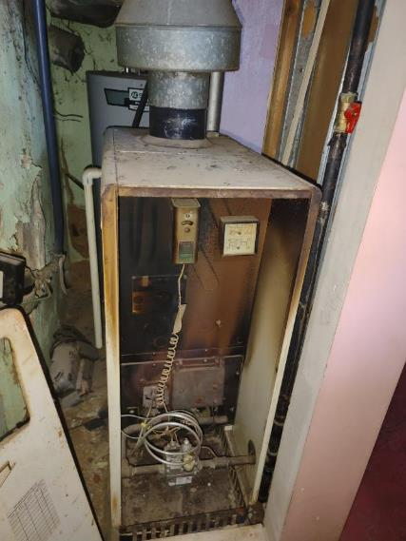
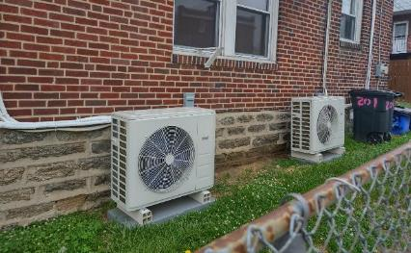
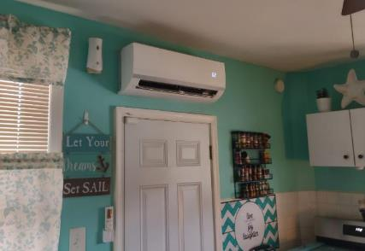
Built to Last as a Solution
Built to Last coordinates resources to stabilize homes so they are affordable, healthy and safe.
Built to Last adds to the home repair ecosystem:
Coordinated intake and scope, fewer applications, construction management
Eliminating deferrals and optimizing benefits
Gap filling for health, safety and overruns
Serves homeowners at or below 60% area median income ($50,160 for 1-person household, $71,640 for four-person household)
BEFORE
AFTER

Slide 5



Administrative Platform
Benefits Screening
Property Assessment
Construction Management
Screen for utility, health, and City housing services
Identify eligible benefits
Collect all information & documents
Complete all applications
Identify all home repair needs
Eliminate referrals to multiple programs
Match the repair needs to available services and funding
Streamline delivery of multiple services
Shorten project timelines
Address all major home needs
Bring in external funding to fill service gaps
Notes:
Time mark- 4 minutes
This graphic here describes the client journey through the program-
First they apply for services through the program one time and are screened for their eligibility for participating services ALLat once (cuts out the need to apply multiple times for separate programs
Then, a comprehensive home assessment is performed. Much like during application screening, this in an opportunity to assess what programs are the best fit for the physical needs of the home. This home inspector then coordinates with all participating agencies on behalf of the homeowner- peicing together a comprehensive work scope. We do fund our own work scope and pay contractors directly to perform that work, but we are doing this with the other programs and services in mind- our goal is to use our scope to unlock the fullest services possible from other program services.

Slide 6

Eligible Measures
Basic Systems
Roof and Building Shell
Electric
Plumbing (interior/exterior)
HVAC + Hot Water
Structural Issues
Enhanced Energy Measures
Solar (where feasible)
Heat pump (heat + AC)
Fuel switching
Energy Efficiency
Health and Safety
Weatherization
Insulation (esp. attic)
LED lighting
Efficient windows/doors
Low-flow water fixtures
Trip and fall hazards
Excess moisture
Lead paint
Mold
Pests
Notes:
Time mark- 5 minutes
When we are going that work in the home we are trying to accomplish as much as we can- Here are the major focus areas we work on- Basic systems- making the home –stable and safe- warm- and dry.
Week look at the livability of the home for the specific occupants- we serve a lot of older adults so this is typcially through a lens of aging in place, but also bringing in integrated pest management, addressing asthma triggers, etc.
We are also looking at energy efficiency potential and deeper retro fit work such as introducing heat pumps, electrificaiton , and roof top solar

Slide 7

Program Partners
Repair Programs
Legal Services
Phila. Housing Development Corporation (Basic Systems Repair)
Energy Coordinating Agency (Weatherization, Health and Safety)
Philadelphia Corporation for Aging
Habitat for Humanity Philadelphia
Community Legal Services
Philadelphia VIP
Health and Housing Counseling
Jewish Families and Children’s Services
Philadelphia Regional Center for Children’s Environmental Health
Neighborhood Energy Centers
Clarifi
Utility Programs
Philadelphia Water Department
Philadelphia Gas Works
PECO
Notes:
Time mark- 6 minutes
Goal- improve home condition and reduce energy burden for low income Philadelphia households.
In Philadelphia- and in many areas there are programs that serve low-income households with services- physical interventions- aimed at improving some aspect of the condition of the home. In Philadelphia we have a constellation of services ranging from weatherization, to utility emergency work, and home repairs.
Other services include housing counseling, legal assistance, and health related programs. All of these programs existed and were sometimes working together, but coordination was ad hoc and unreliable. Built to last was created to operate as an administrative back bone to coordinate and supplement these services through one-streamlined program.

Slide 8
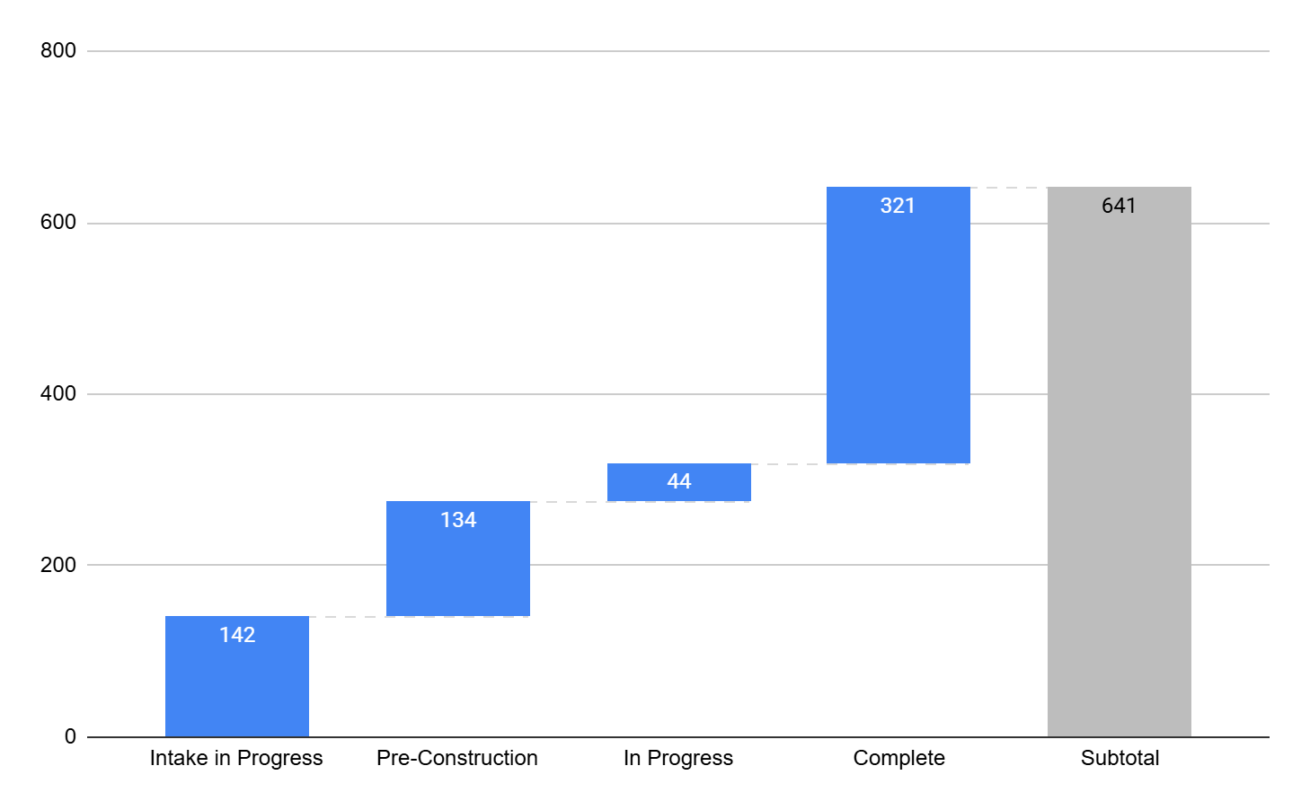
Production Pipeline
Currently there are 3702
applicants on BTL’s waitlist

Slide 9
Case Studies

Slide 10
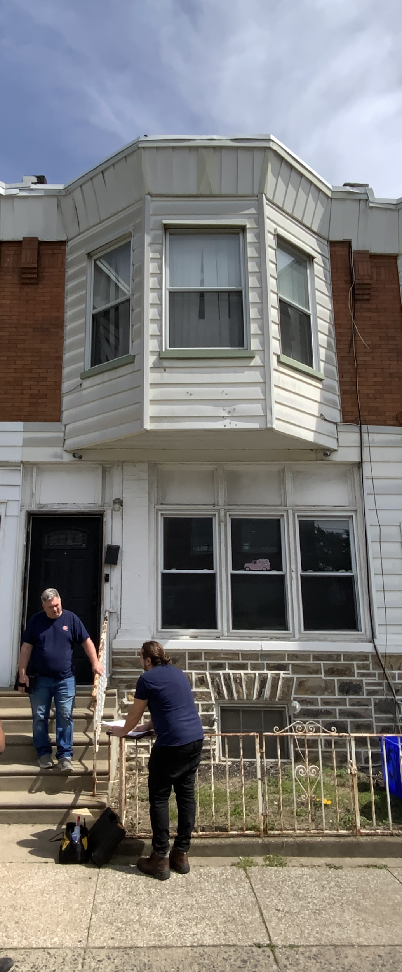
65th Street
Address Hazards
Remediate friable asbestos
Repair gas leaks
Install Dehumidifier
Upgrade ventilation
Improve Durability & Safety
Roof Replacement
Upgrade Efficiency
Air Seal and Insulate
Lighting
Water Efficiency
Electrify Equipment
Upgrade electric panel
Mini split heat pumps
Heat Pump Water Heater
Add Renewables
Solar Lease
Notes:
Now let’s get into some examples. For this first case study, we’re going to move through slowly and talk through the process while we talk about the scope proposed for the property.
As we’ve iterated a number of times already, you have to deal with the health, safety and durability first. As Emily mentioned in her slide about the home condition continuum, you need to start by reaching for the minimum standards, then durability, safety, and functionality.
Here you can see the orange and yellow boxes representing the critical upgrades that need to be included in the scope before efficiency or electrification could be considered for this house.
Once critical repairs have been addressed you can begin to upgrade the efficiency of the home.
Lighting and water efficiency measures are simple, low hanging fruit, don’t get so excited about putting in a heat pump that you don’t put in LED’s!
As we discussed in the last slide, air sealing and insulation are KEY elements in the efficiency step.
Once you’ve dealt with the building enclosure, you can work on upgrading the equipment in the home.
Electrification almost always requires an electrical panel upgrade in these homes.
To electrify the heating system, a Manual J calculation is necessary to size the new system accurately.
A quick note on Manual J calculations: They are all not created equal. To electrify, you need a really good Manual J that takes into account the buildings insulation levels, actual dimensions, and REAL air leakage numbers.
If you can, electrify everything. We’ll get more into this in a bit.
Then go ahead and add your renewables. In this case a solar lease.
Additional Notes on this scope:
No dryer in the house.
Homeowner was not open to replacing their range.

Slide 11
65th Street
Projected yearly site energy reduction 89%. Site carbon emissions, projected to be down 72%.
Reduce Energy Used on Site.
Reduce Utility Costs
Electrify Where Possible
Reduce carbon produced on site.
Notes:
Time Mark- 25 minutes
Let’s break down the projected results for this property. This is a very busy slide, but I think it will be worth it!
At the top of the slide you can see that these are PROJECTIONS. We have done our best to be as accurate possible and to calibrate our models to the actual energy bills of the homeowners, but this data has not been pulled actual energy usage data and these scopes have not all been completed yet. As the scopes change during implementation, the potential savings will change as well.
At the top of the slide you can see the total site energy reduction that has been predicted. If you remember, the WAP Enhancement grant’s goal is to achieve at least a 40% site energy reduction.
Down through the center you can see our 4 major goals for each property. Energy, Costs, Electrification, and Carbon. Surrounding those 4 goals are the graphs that represent the progress projected for this property.
Top left in magenta is the total site energy measured in Millions of BTU’s/year.
Notes on the graphs:
Cost savings do not include savings that may come from the solar leases. There is savings there, but we don’t have enough data at this time to be able to incorporate that into the utility cost data.
The circled and highlighted element here is the post intervention gas projection.
This homeowner did not want to change out her gas stove for an induction stove.
In Philly in 2024, the monthly utility customer charge was $14.90. To have that gas stove sitting in her house this homeowner will pay 179$ a year.
Assuming the lifespan of a range is about 15 years, she will pay AT LEAST $2,682 to the gas company in that 15 years. Just to have the gas stove. It does not include the gas needed to actually cook on it.
That math is pretty convincing. Getting rid of that monthly gas charge can also make the difference between cost parity or savings with electrification versus a price increase from the conversion.
Education is needed to help homeowners understand the value of changing out their clothes dryers and ranges to electric. Beside the health, safety, and carbon reduction benefits, there is a very strong financial case to be made.
It’s an uphill battle, but worth it.

Slide 12
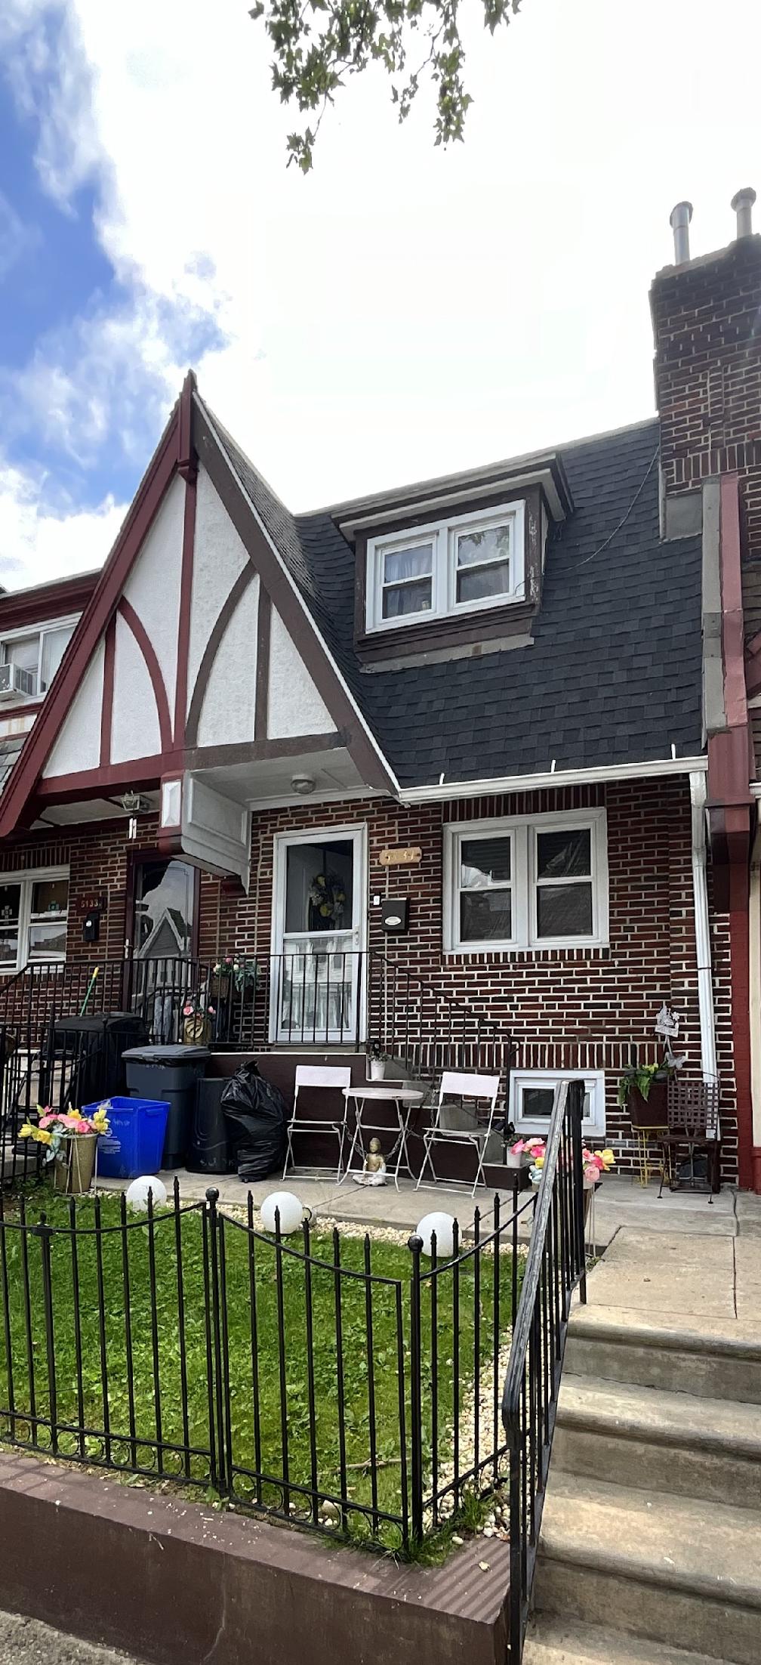
8th Street
Address Hazards
Replace knob & tube wiring
Upgrade ventilation
Improve Durability & Safety
Bathroom Accessibility Upgrades
Upgrade Efficiency
Air Seal and Insulate
Lighting Upgrades
Water efficiency Measures
Electrify Equipment
Upgrade electric panel
Heat Pump
Heat Pump Water Heater
Add Renewables
Solar Lease
Notes:
We’ll move through these next examples a little more quickly now that we’ve gotten a sense of the format.
At this property, full electrification was achieved. (This project is actually complete now.) One element that was helpful here was that the property was in decent condition from the start. Importantly the roof was in good shape- fairly new and did not need replacement. Weatherization’s team went first here which really helped make some of the decision making quick and simple.

Slide 13
8th Street
Projected yearly site energy reduction 86%. Site carbon emissions, projected to be down 68%.
Reduce Energy Used on Site.
Reduce Utility Costs
Electrify Where Possible
Reduce carbon produced on site.
Notes:
Time Mark: 28 minutes
On this property, full electrification was achieved. You can see the great projected results. We won’t know how close our models are until a year has passed, but it looks really good right now.

Slide 14
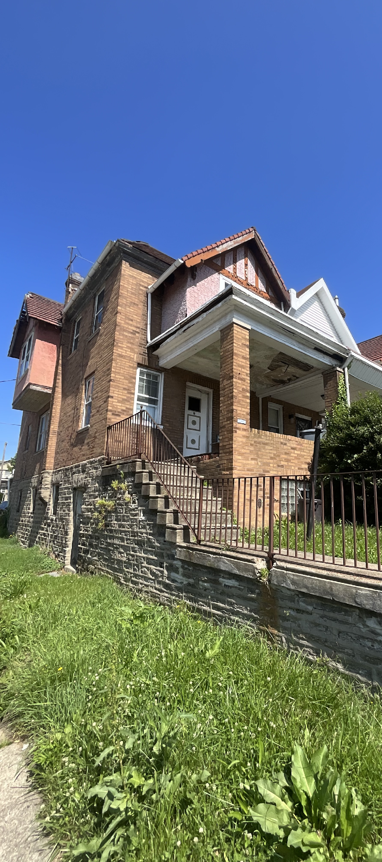
Smedley Ave
Address Hazards
Lead remediation
Replace knob and tube wiring
Revent dryer
Add dehumidifier
Upgrade ventilation
Improve Durability & Safety
Main Roof Replacement
Porch Roof Replacement
Siding replacement
Kitchen cabinets & plumbing
Exterior Door
Aging in place
Upgrade Efficiency
Air Seal and Insulate
Lighting Upgrades
Water efficiency Measures
Upgrade Equipment
Upgrade electric panel
Install gas 95% furnace
Add Renewables
Solar Lease
Notes:
Smedley is an example of the other end of the spectrum from Tabor. This is a property that is at the beginning of that home condition continuum that Emily talked about earlier in the presentation. It had significant health, safety and durability challenges that needed to be addressed. Critical home repair needs were dominant here and every available cent needed to go to making this property live-able. Electrification would have required enough additional work and cost that there just wasn’t any money to include it.

Slide 15
Smedley Ave
Projected Yearly Site Energy Reduction 48%. Site carbon emissions, projected to be down 48%.
Reduce Energy Used on Site.
Reduce Utility Costs
Electrify Where Possible
Reduce carbon produced on site.
Notes:
Time Mark: 34 minutes
The results are still good without the electrification. 48% is a great result.
Interestingly, the solar lease here will mean that projections show that the site could actually produce more electricity on site that the property will produce at the end of the project.
This is because the number of kilowatts used by the property is projected to be every low. Most of the needs at the property are met by natural gas equipment that cannot be offset by solar.

Slide 16
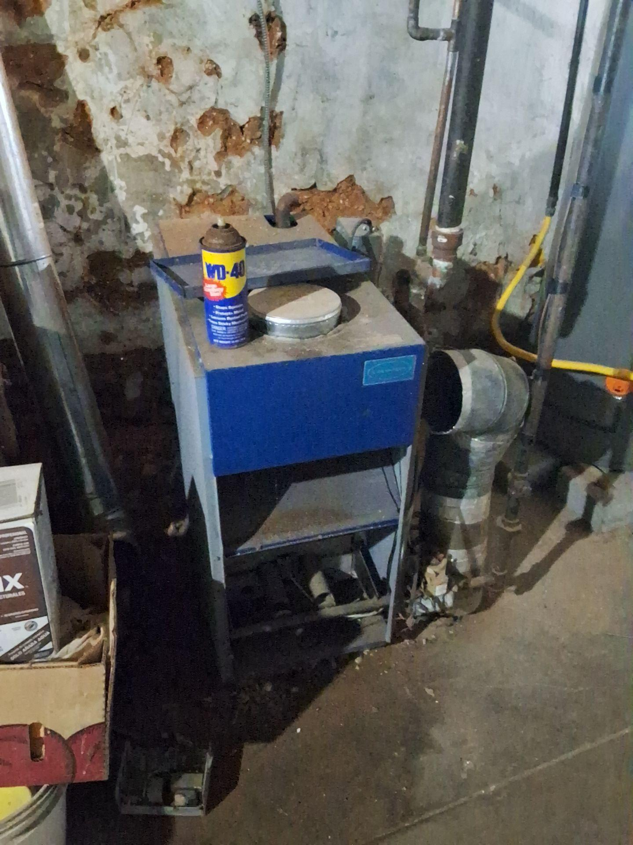
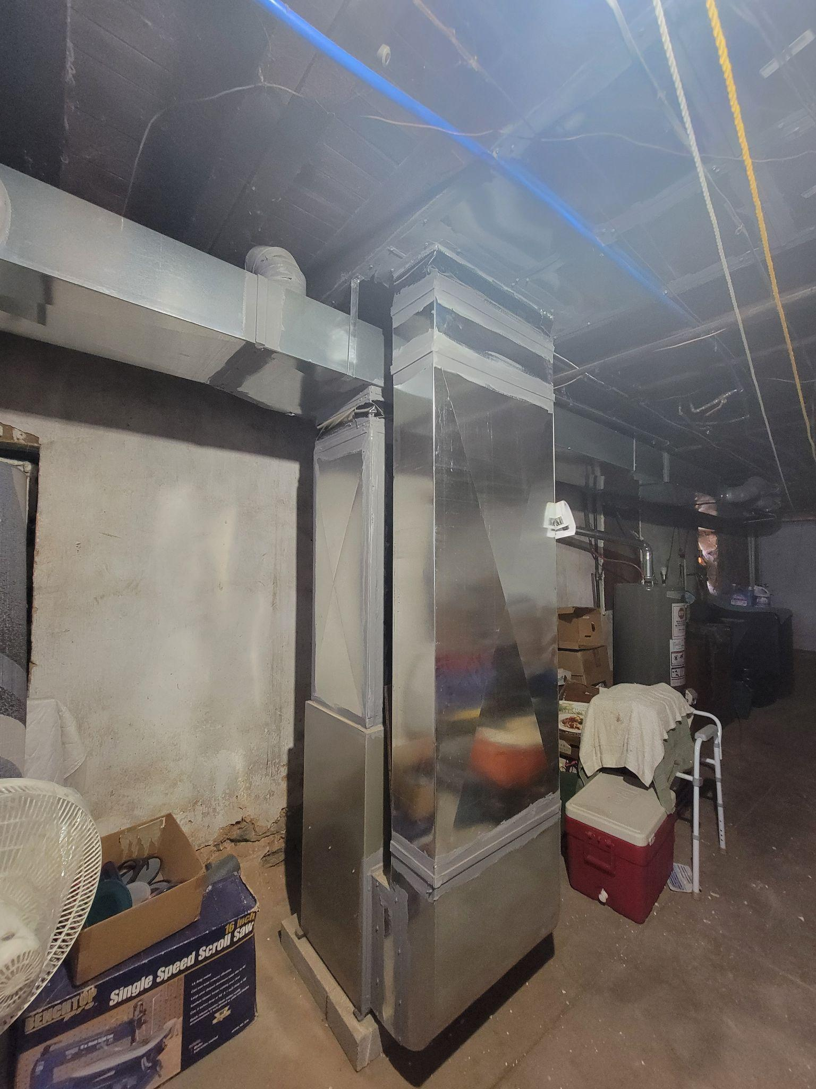
Before After

Slide 17
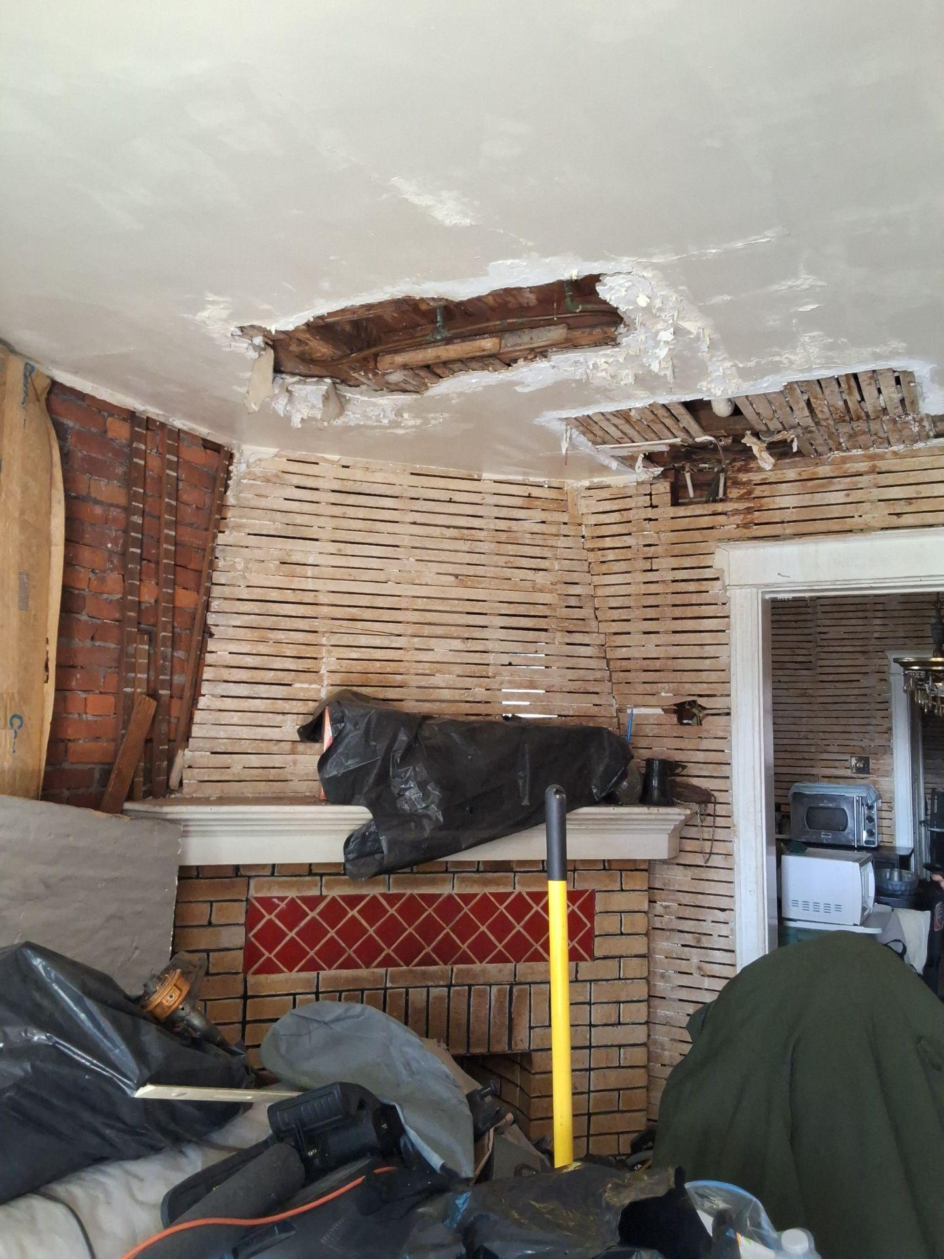
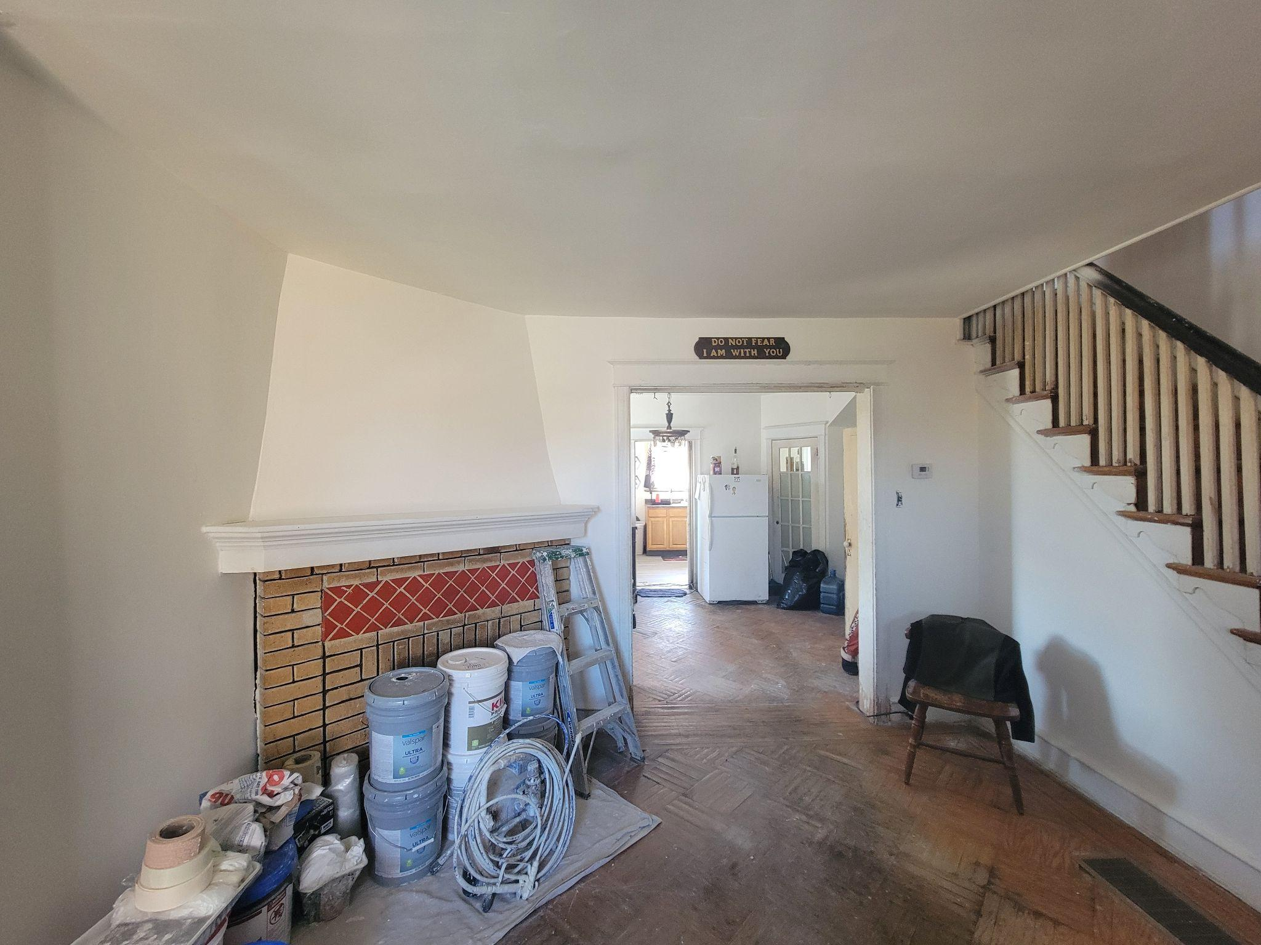
Before
After
After

Slide 18
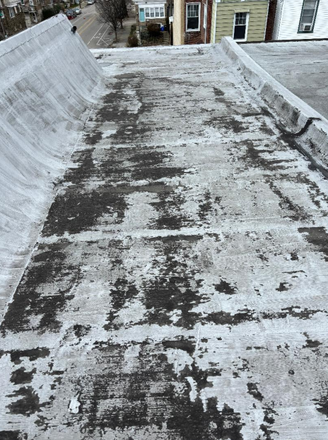
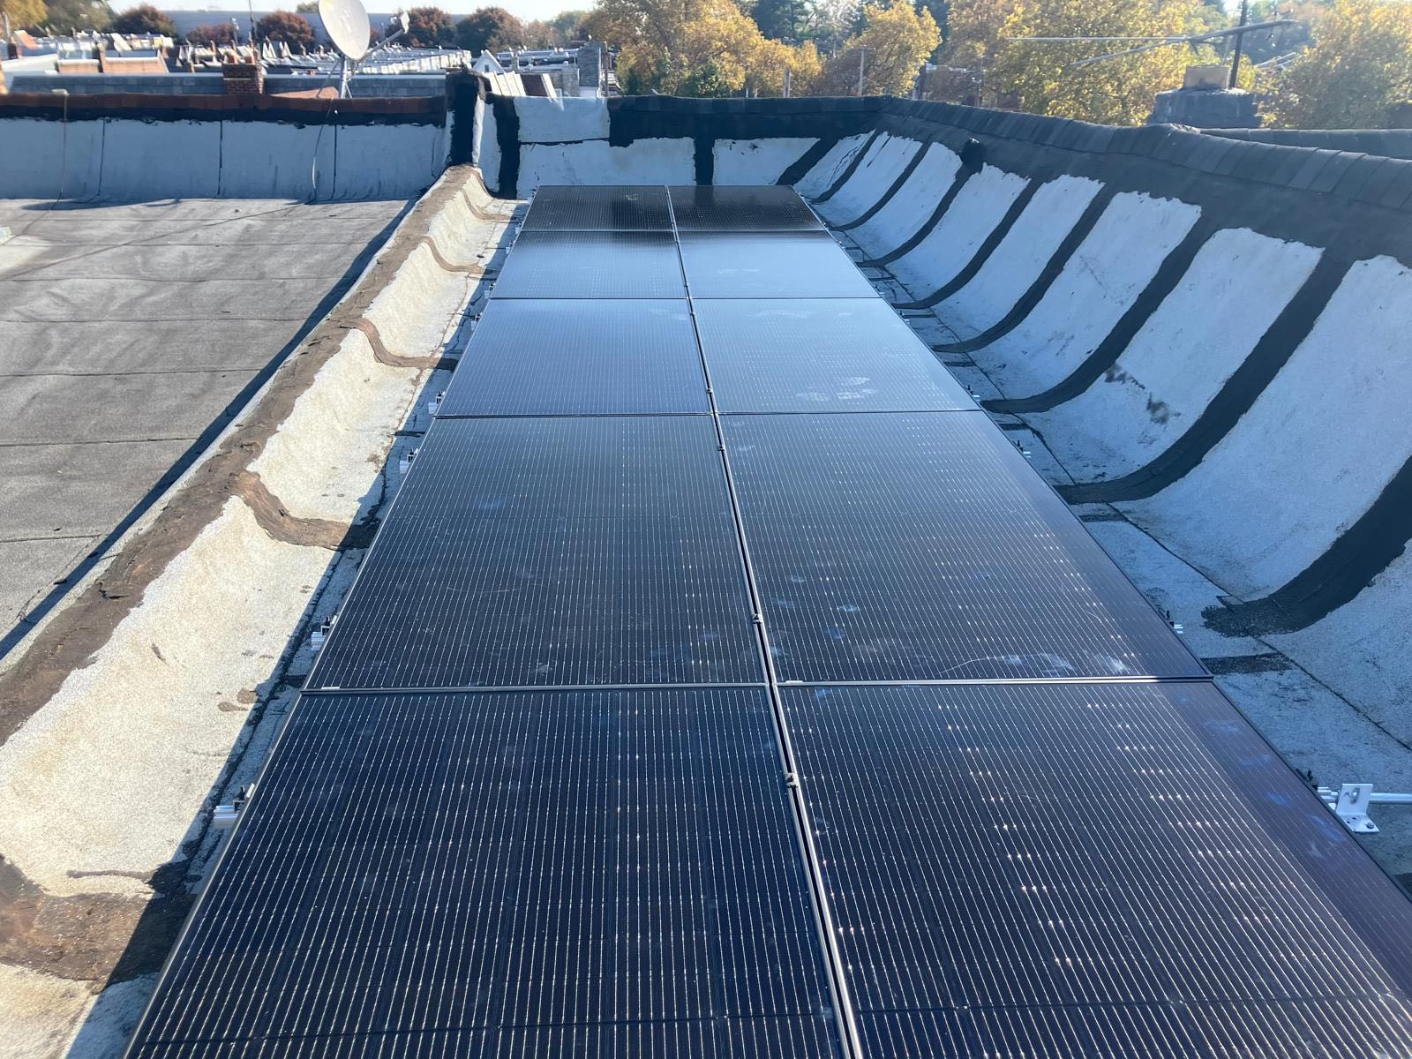
Before
After
After

Slide 19
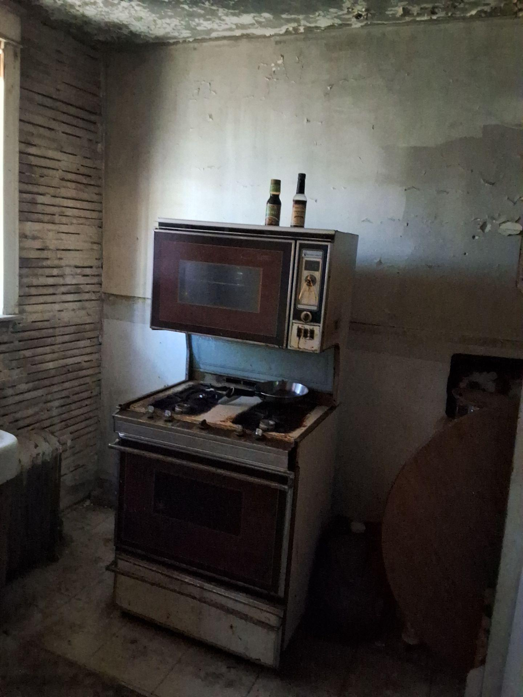
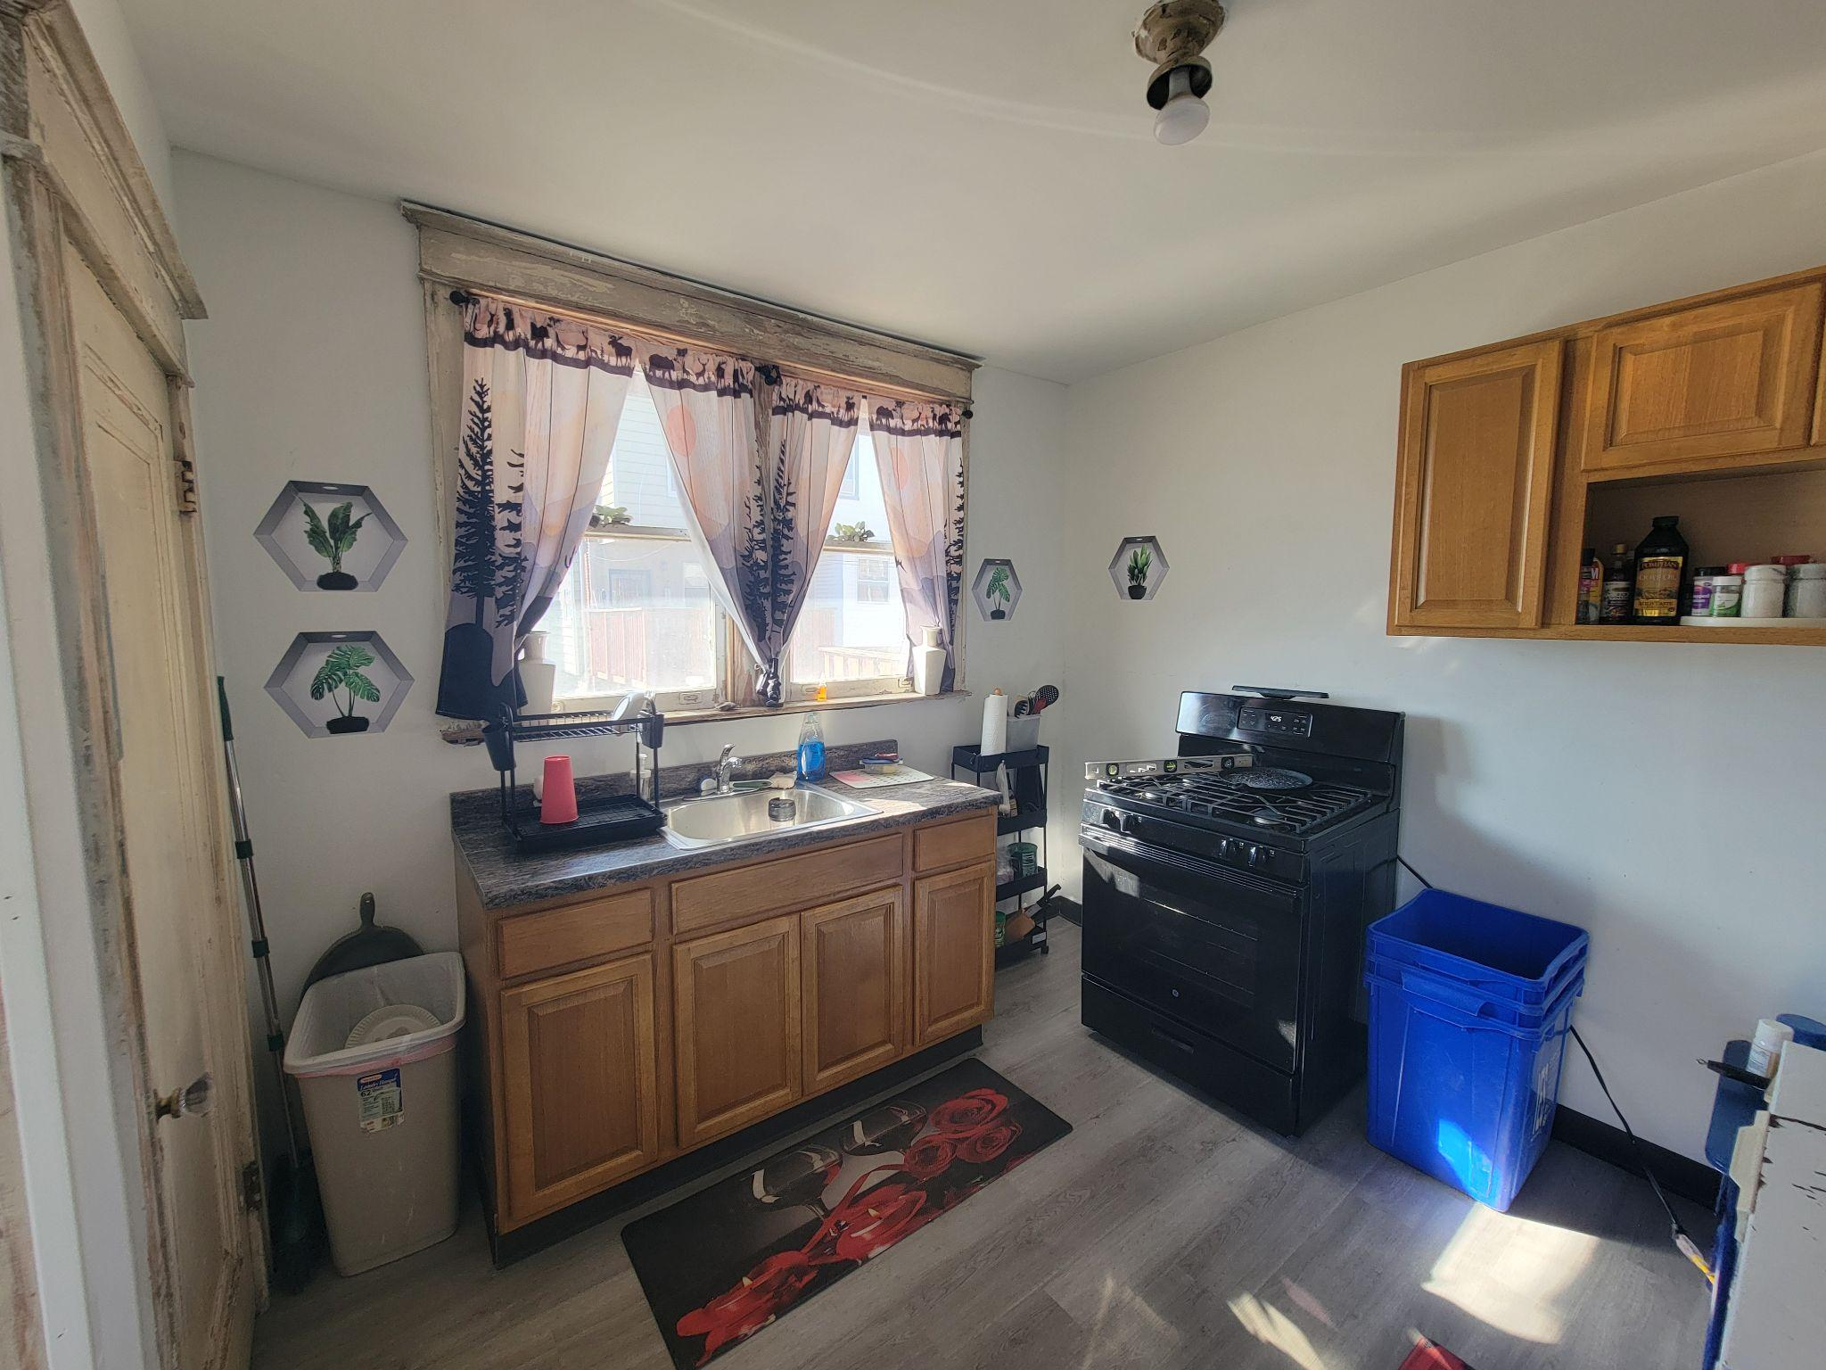
Before
After
After

Slide 20
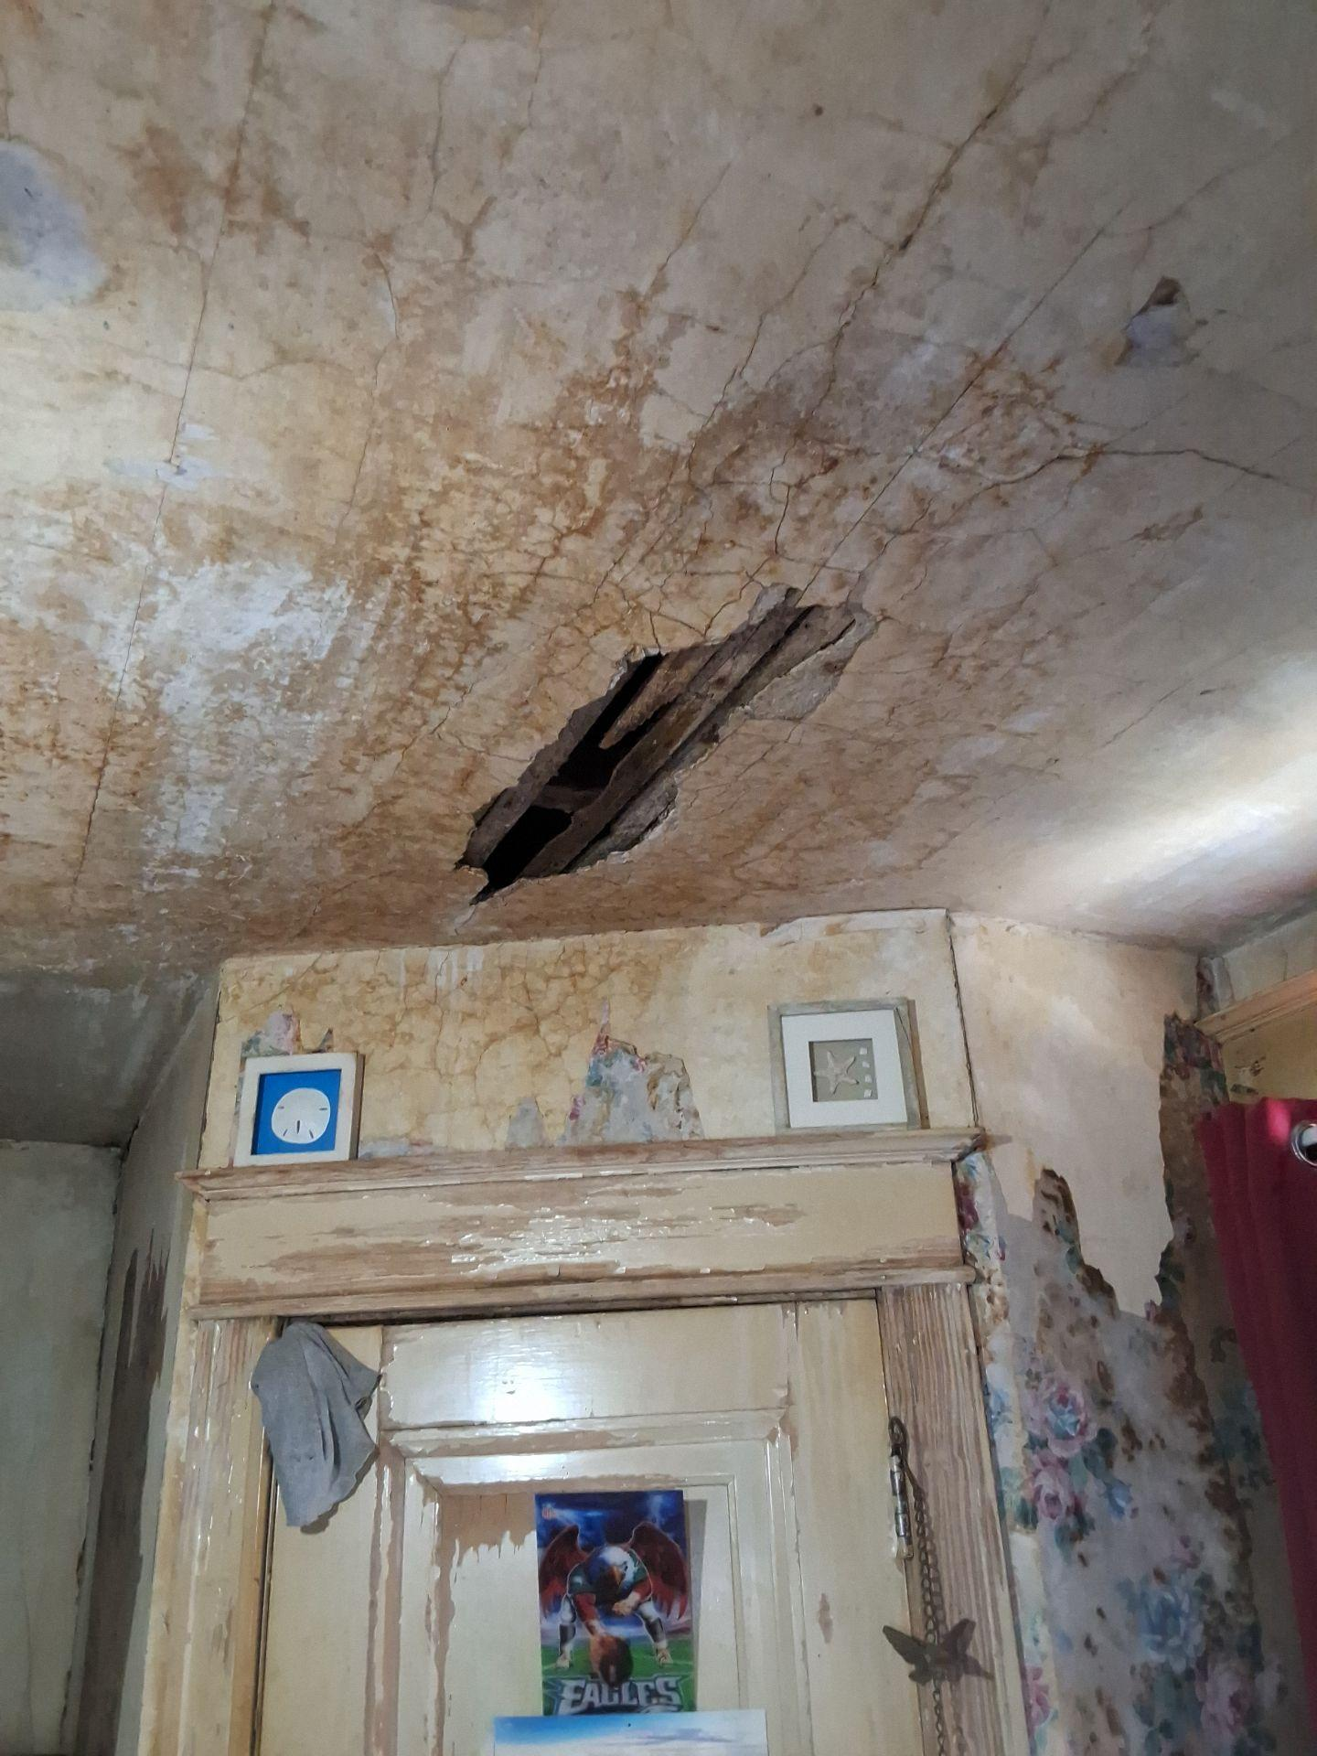
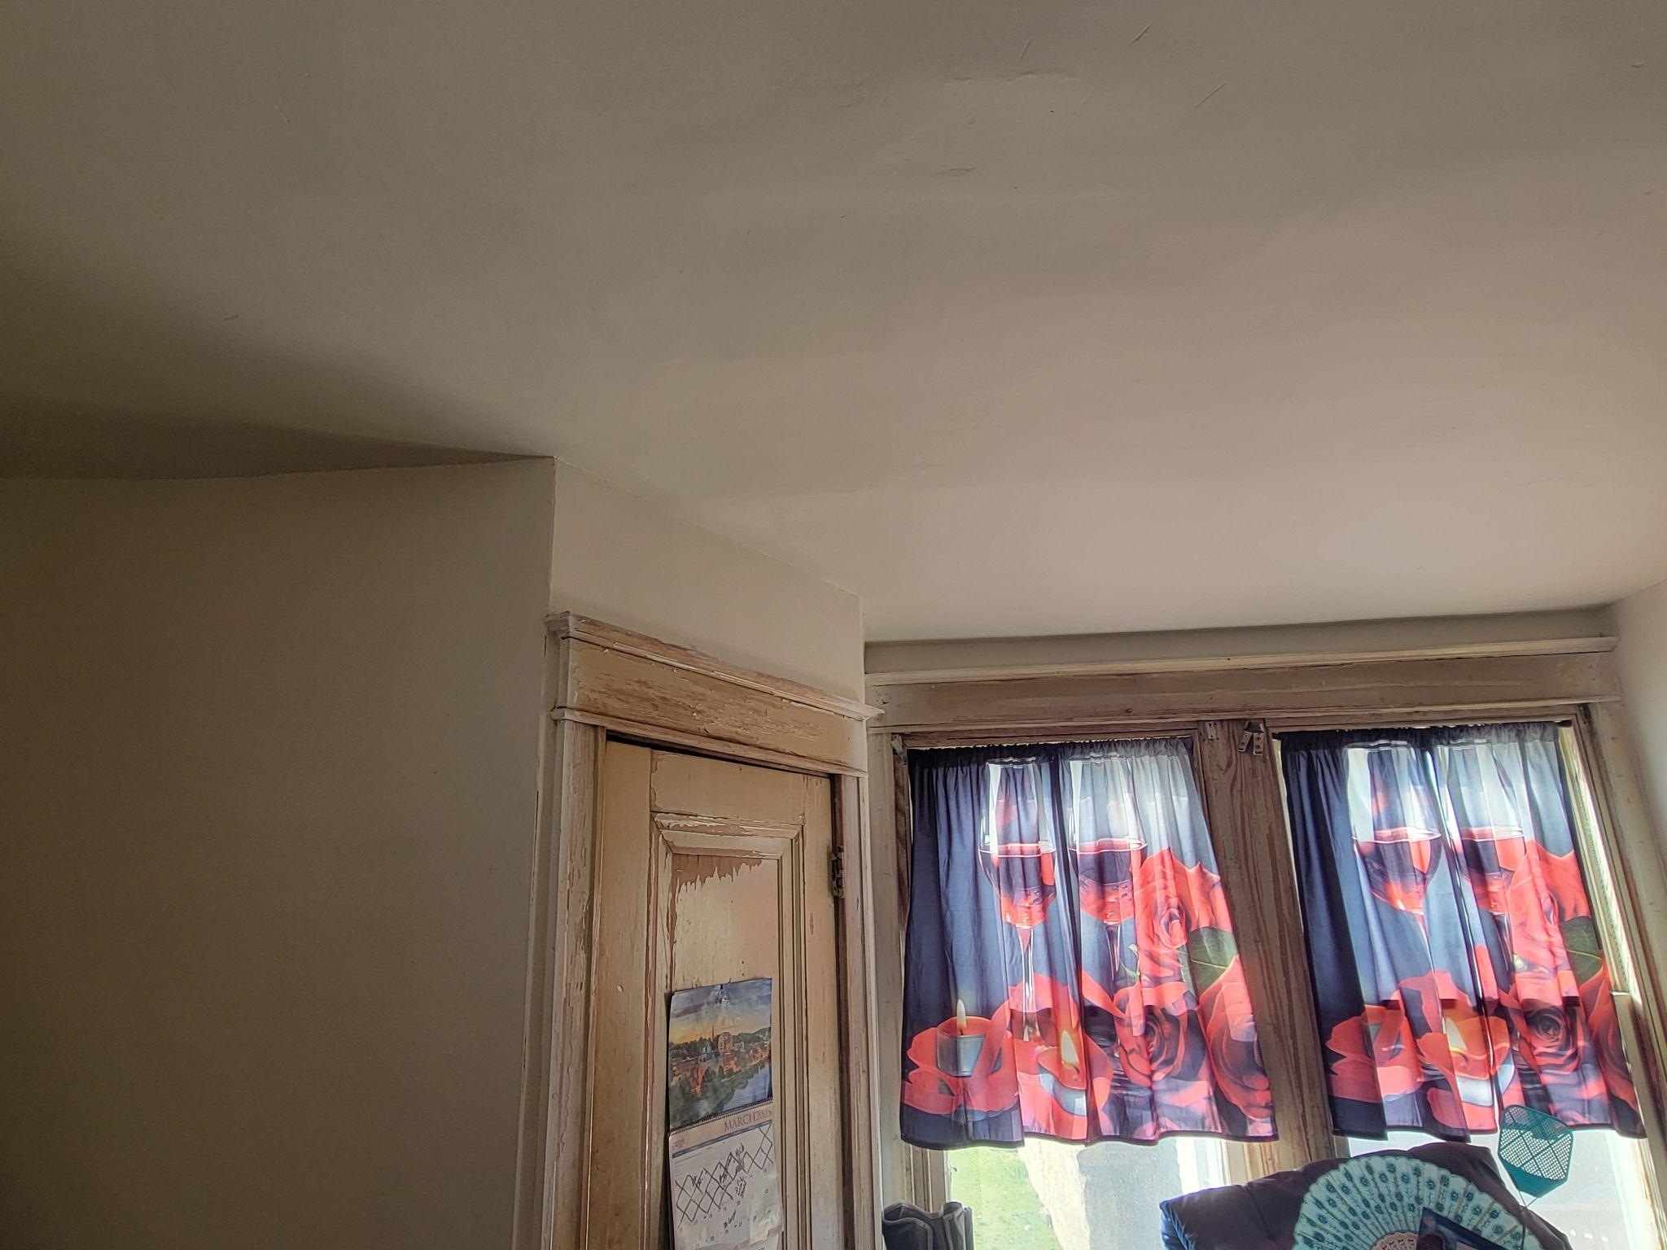
Before
After
After

Slide 21
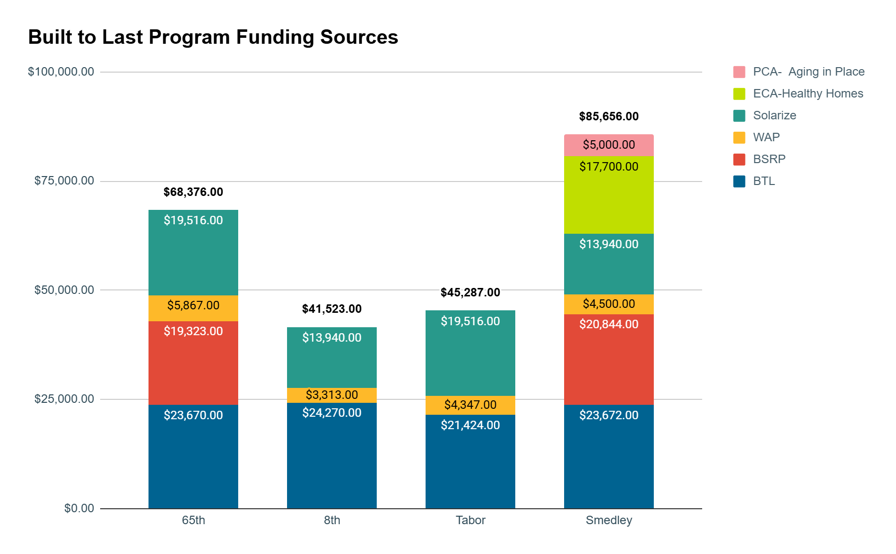
Notes:
Time Mark- 41 minutes
Add totals to the top- Emily reworking some of the actual info on the solar costs- reorder properties

Slide 22




Coordination Learnings
Deep energy retrofits require high levels of communication and sequencing among partners
Central oversight across all partners to avoid critical elements falling through the cracks and/or overlapping work. Example: electric panel replacement (repair and electrifications scopes)
Support sign-up for homeowner assistance with electric utility to make sure their costs don’t rise.
Homeowner resource and education for new technology (solar, induction stoves, etc.) - acceptance that there may not be buy-in
Notes:
Time Mark : 47 minutes
Order of work matters and is challenging with multiple partners. Need flexibility from partners to mix it up from time to time.
Someone needs to track scopes across all partners to avoid critical elements falling through the cracks and overlapping work. Example: one contractor installing a 100 AMP panel to resolve a need they are trying to solve- then the next contractor coming in and realizing that a 200 AMP panel is needed for their scope. This can be avoided by good communication.
Some homeowners may need assistance setting up energy assistance with the electric utility to make sure their costs don’t rise.
Homeowner education and buy-in- remember- at the end of the day this is their home and they have their own needs and priorities. Everyone has their own hierarchy of needs- sometimes people do not want to talk about roof top solar because they have been so focused on a critical repair need in their home. Even if we are ready to try to do everything at once, they client may not be on the same page. That buy-in is absolutely critical in the success of doing deep energy retro fit work.

Slide 23

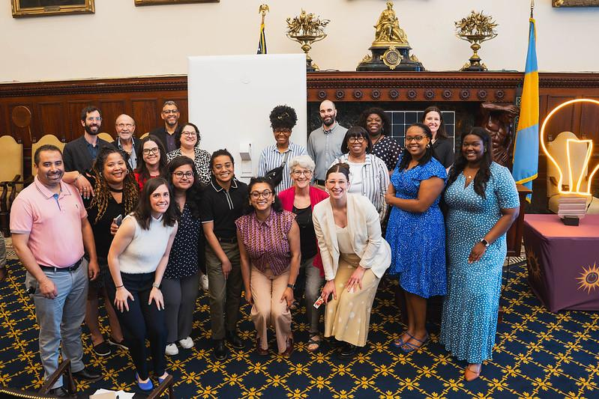
Contact:
Katie Bartolotta
Vice President
kbartolotta@philaenergy.org
www.philaenergy.org

