Slide 1
Governor
Kathy Hochul
Commissioner
RuthAnne Visnauskas
HCR Sustainability

Slide 2
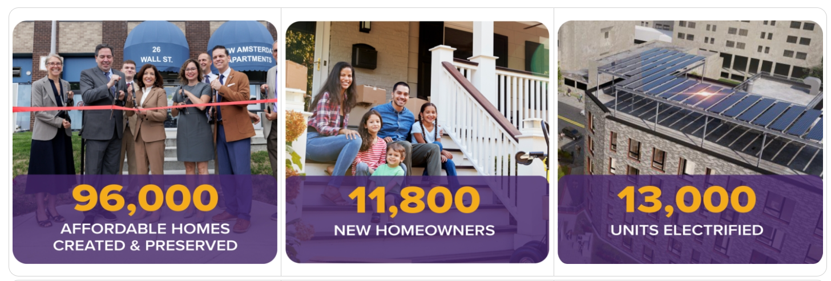

NYS Homes and Community Renewal

Slide 3
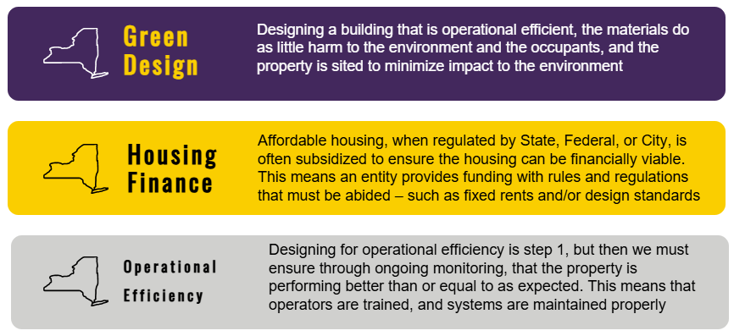

Slide 4
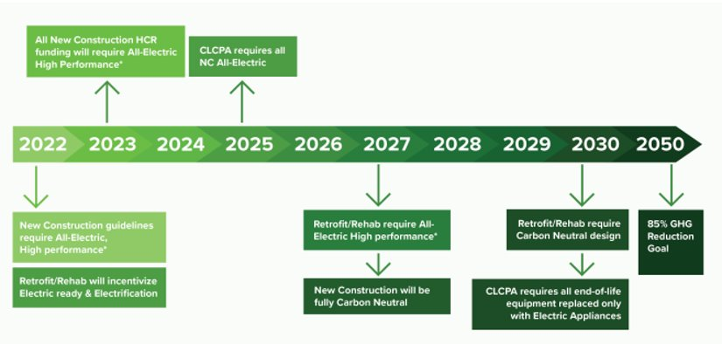
HCR’s Sustainability Road Map
The Sustainability Guidelines were designed to set standards that aligned with the State's CLCPA of 2019, as shown in the timeline.
In 2021 HCR launched the pilot of the Clean Energy Initiative with NYSERDA.
To fund deep energy retrofits and decarbonization work.

Slide 5
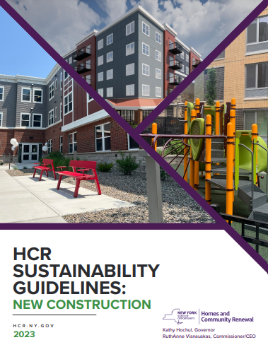
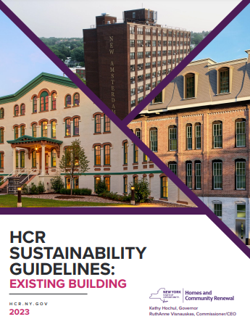
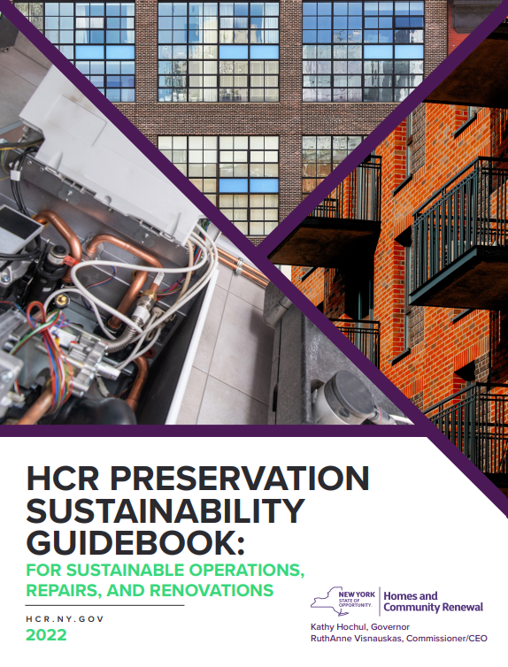
HCR’s Sustainability Guidelines
HCR Sustainability Guidelines were initially launched in 2021.
There have been two major updates, released in 2023, and most recently in 2025.
The Guidelines are applicable to all Multifamily projects receiving:
  9% LIHTC,
  4% LIHTC and Stand-alone tax-exempt bonds,
  HCR subsidy, and
  HCR SLIHC stand-alone financing
The Guidelines set a minimum set of requirements for properties to design to that align with the State's goals for highly efficient buildings.

Slide 6
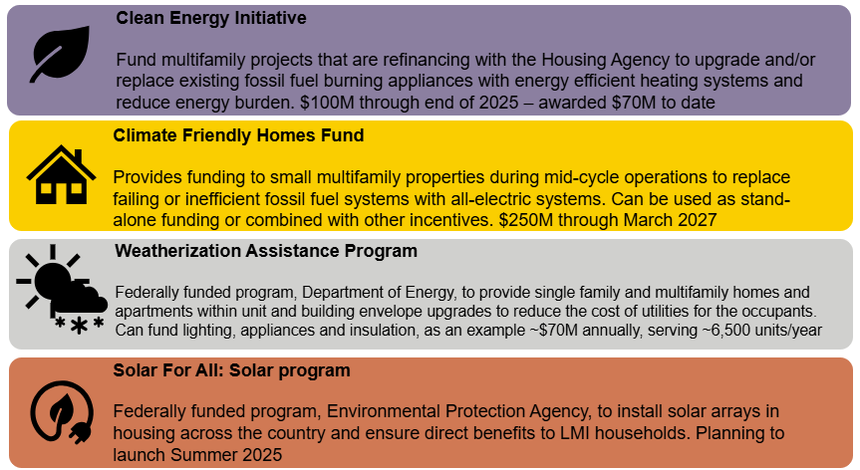

Slide 7
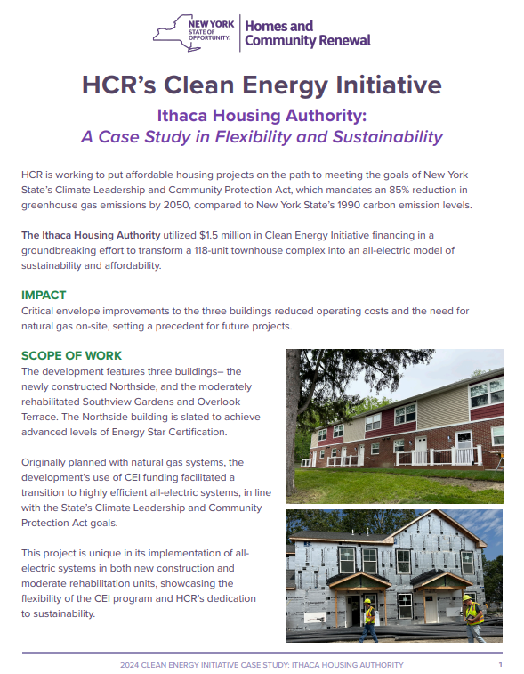
HCR's Clean Energy Initiative
The Clean Energy Initiative Program (CEI) was launched as pilot in 2021, in partnership with NYSERDA and HCR.
The program provides gap funding to affordable housing developers, filling the cost gap between achieving baseline requirements to meeting an all-electric, or partially electrified, building design leading to deep decarbonization.
The funding is deployed as a subsidy source, allowing the funds to be used as a source in financing when the developers structure their financing. This reduces challenges with incentives or delayed payments previously experienced, while having HCR provide technical oversight in real-time to manage quality assurance.
The program maintains three term sheets that describe the terms of the program, and reference technical standards in the Sustainability Guidelines

Slide 8

Role of Technical Assistance Providers (TAP)
We heard from the market, navigating the technical space of heat pump type selection, certification process with green energy performance programs, and the integrated design process can be confusing, especially for first time decarbonization teams.
Provide direct support for Clean Energy work scope items
Expertise in Passive House and high-performance building standards
Compliance with the CEI Program
Notes:
James

