Slide 1


Helping North Carolina Communities Manage Extreme Heat
Extreme Heat Summit, Center for Energy Poverty and Climate
August 15, 2025
Notes:
Before we started this work, heat management work was not happening anywhere in the state in a coordinated way, at least as far as we can tell. The reasons were that “we live in the south” and “we have that in our hazard mitigation plan.”

Slide 2
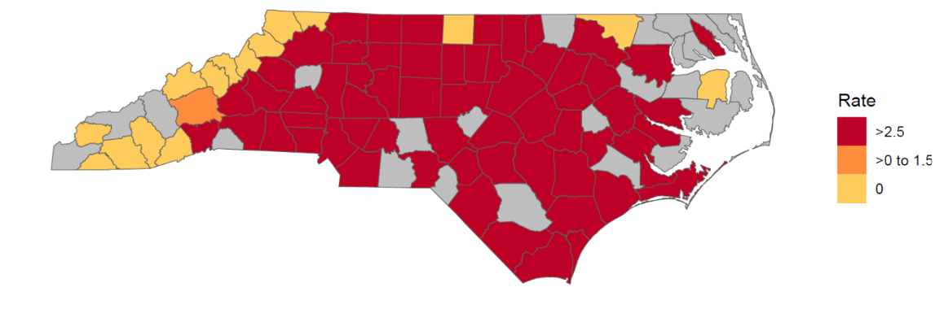
Rate of Heat-Related Illness Emergency Department Visits per 100,000 population June 22-28, 2025
Gray counties: data suppressed for counties with less than 500 ED visits.
Notes:
We are worried about heat mortality and morbidity. In NC, we track the number of people going to the emergency department for HRI.
Chart: 2025 – we have already surpassed 3,000 this year as of the middle of July.
Last week of June: Heat wave sent more than 1,000 people to the ED in one week.

Slide 3
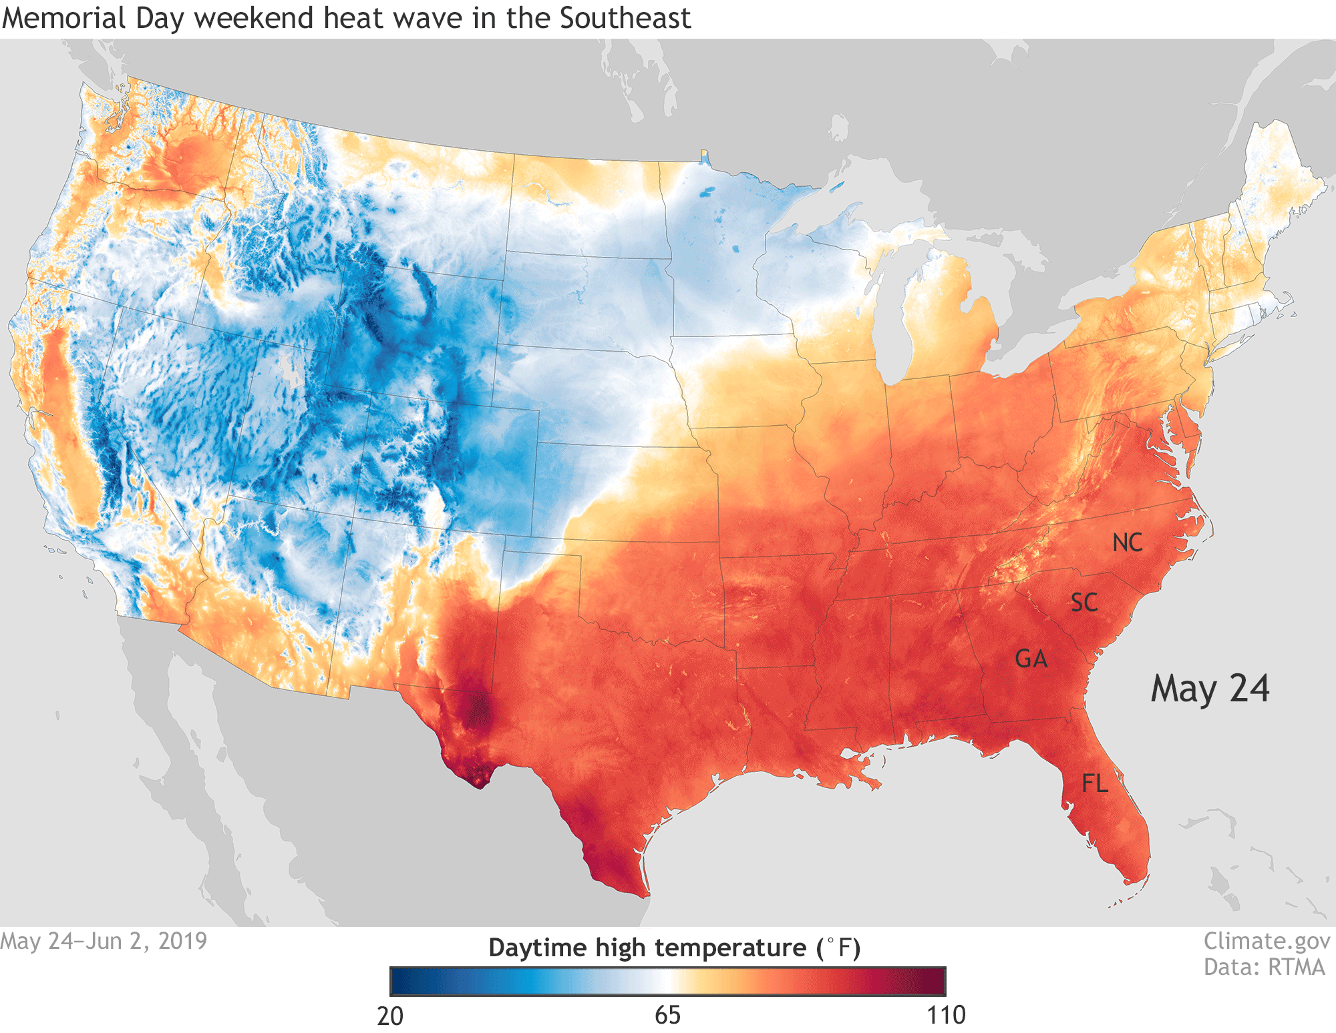
Happening in NC
Heat Health Alert System
Heat Thresholds
Heat Action Plan Toolkit
Planning for Extreme Heat Cohort
Not So Fun Facts

Slide 4
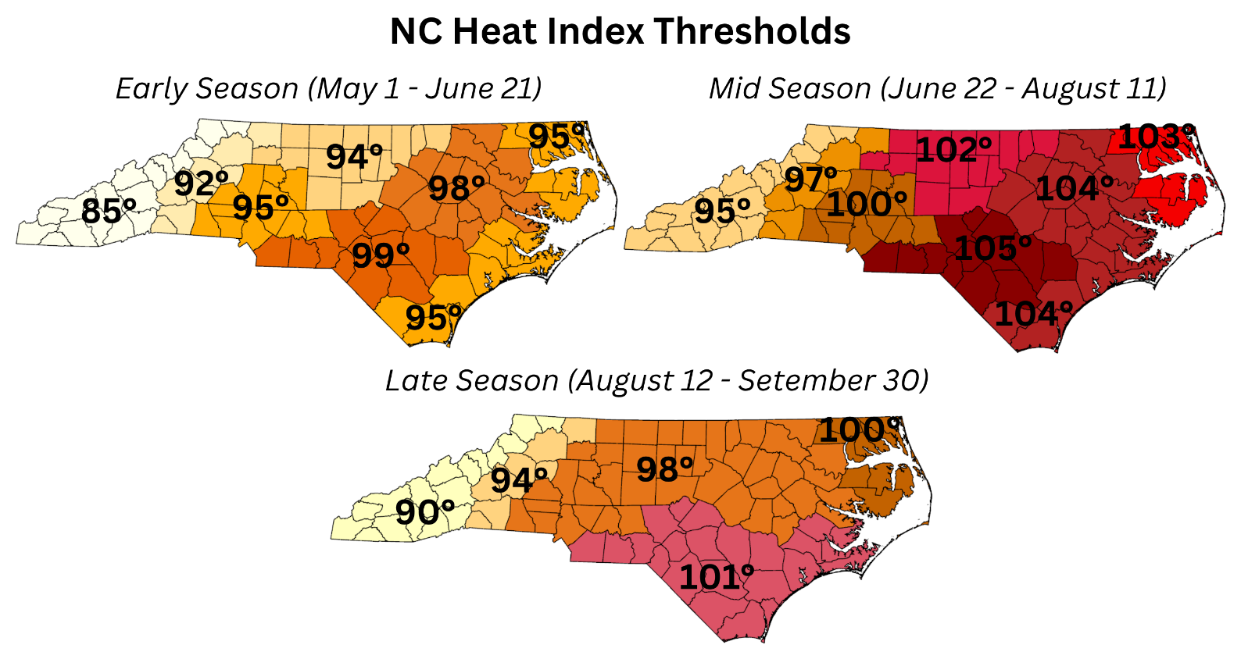
Heat Thresholds and Heat-Health Alerts
Notes:
Counties with similar climates are grouped into 8 regions.
Early Season (May 1-June 21): lower thresholds when our bodies aren't yet used to heat
Mid-Season (June 22-August 10): higher thresholds when we've adjusted to summer heat
Late Season (August 11-September 30): lower thresholds as summer winds down

Slide 5
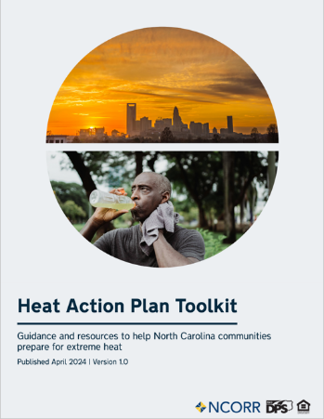
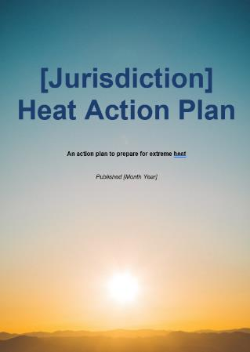
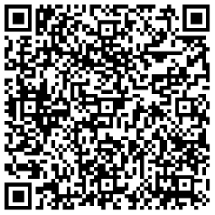
Heat Action Plan Toolkit
Technical Instructions
Heat Action Plan Template
Identifying high-risk residents
Identifying thresholds for extreme heat
Defining the heat season
Formatting
Introductory text
Why extreme heat preparedness is important
Heat related illnesses
31 draft actions
During the heat season
When an extreme heat event is forecasted
Long-term management strategies
Supplemental Materials
Sample checklists
Sample community surveys
Sample messaging
Sample graphics
Notes:
Extreme Heat in NC Webinar recording
Sample checklists
Sample community surveys
Sample messaging
Sample graphics

Slide 6




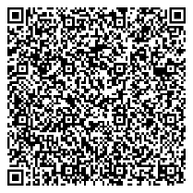


Planning for Extreme Heat Cohort
Program Hosts:
State Resilience
Office
Build a heat action plan
Build a support network
No cost to participate
Seven-month program
Bi-weekly virtual
training sessions
Program Partners::
Notes:
We wanted communities to use the toolkit, so we set up a cohort program to guide them through it.
Jointly offered by the State Climate Office and State Resilience Office
No fees to participate

Slide 7
Cohort Topics
Cohort Support
Heat Trends, Projections and Terminology
Human Health Impacts of Heat
Economic and Infrastructure Impacts
Extreme Heat and Energy
How to Define Your Local Extreme Heat Event
Locating Your Heat Data
Identifying Vulnerable Populations
Action Options
Student GIS Team
Experts in:
Epidemiology and Human Health Impacts
Climate Science
Climate Adaptation
Impacts on Infrastructure and the Economy
Hazard Mitigation Planning

Slide 8
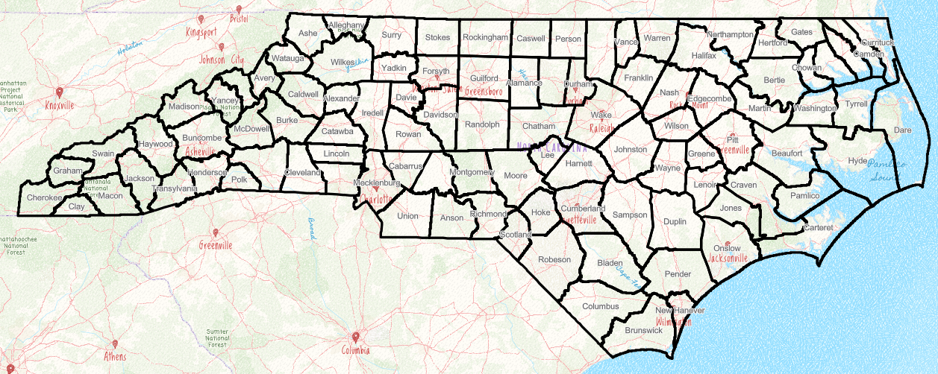
















Planning for Extreme Heat Cohort Program
2024-2025 Participants
Burlington​
Charlotte-Mecklenburg County​
Chatham County​
Greensboro​
​ Orange County: Carrboro, Hillsborough, ​Chapel Hill
Upper Coastal Plain Council of Governments​
Notes:
We wanted communities to use the toolkit, so we set up a cohort program to guide them through it.
Six teams, 10 communities, 28 individuals
Countywide partnerships
Met weekly from January – April 2025.

Slide 9
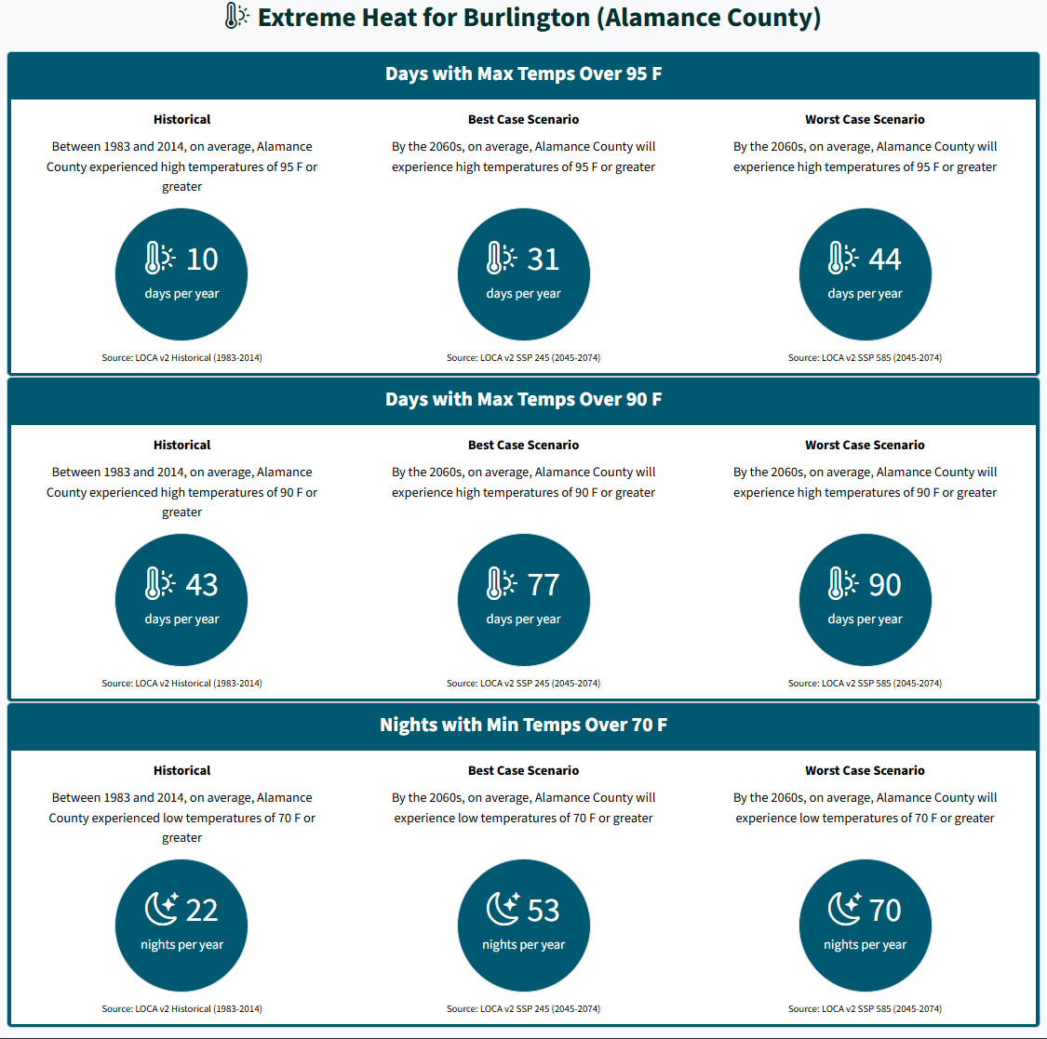
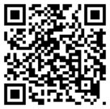
NC Resilience Exchange
Climate Projections

Slide 10
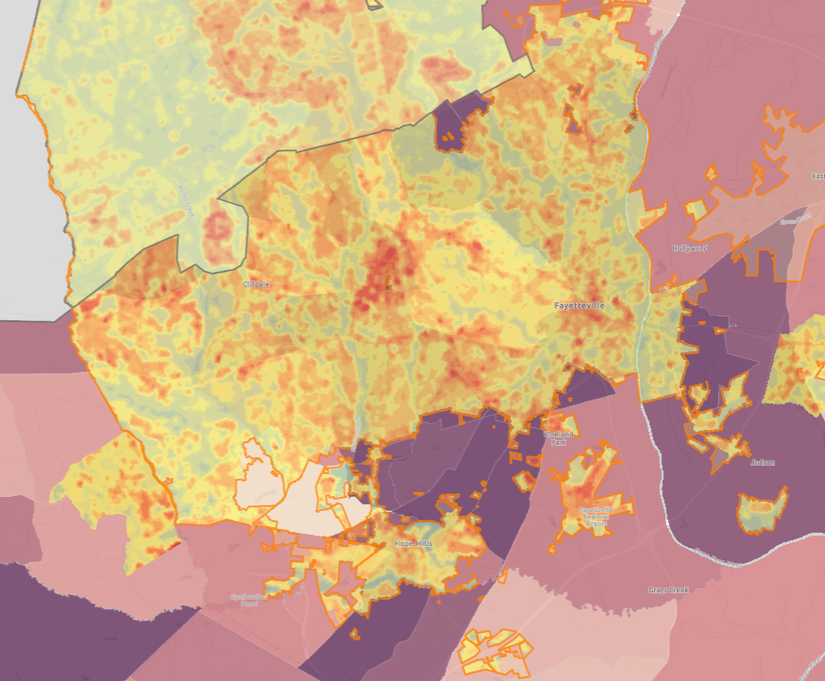
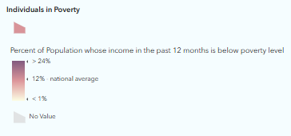
NC Resilience Exchange
Vulnerability Map
Notes:
Map: Heat.gov’s Full range heat anomalies from 2022
https://tpl.maps.arcgis.com/apps/mapviewer/index.html?layers=26b8ebf70dfc46c7a5eb099a2380ee1d
Vulnerable populations questions
Which residents need a place to go during a heat wave? ​
How will they get there?

Slide 11
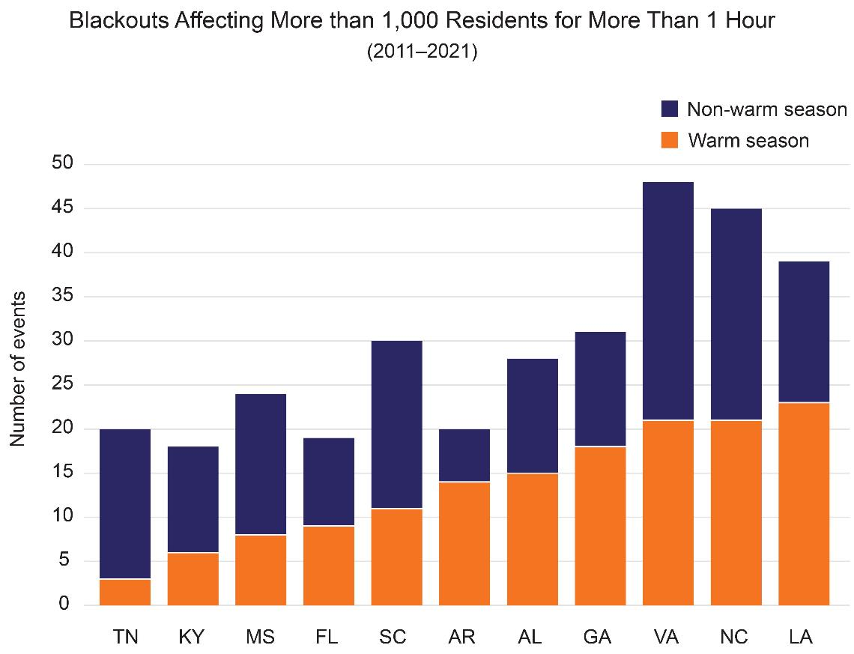
Not So Fun Fact #1
Heat season overlaps with hurricane season
May | Jun | Jul | Aug | Sep | Oct | Nov
Heat Season
 | Hurricane Season
Source: Fifth National Climate Assessment, Southeast Chapter
Notes:
The other big risk we face in NC is that heat season overlaps with hurricane season.
Tropical Storm Chantal hit several communities in the central part of our state on July 6th. With 8 to 10 inches of rain falling in only 12 hours or so, the flooding was significant, especially in Alamance, Chatham, and Orange counties – all counties participating in our 2024-2025 Planning for Extreme Heat cohort. They reported that, following the storm was a lot of high heat during a time when residents needed to be outside to clean up after the storm.
We also worry about power outages.
NC ranks 2nd in the southeast for the highest number of blackouts affecting more than 1,000 residents for more than one hour. We rank second all year long and are behind Louisiana and tied with VA for the most power outrages during the heat season.
This is TERRIFYING.

Slide 12
Not So Fun Fact #2
Heat-related illness rates in NC are higher for A. urban residents
B. Rural residents
C. They are about the same
Notes:
The other big risk we face in NC is that heat season overlaps with hurricane season.
Tropical Storm Chantal hit several communities in the central part of our state on July 6th. With 8 to 10 inches of rain falling in only 12 hours or so, the flooding was significant, especially in Alamance, Chatham, and Orange counties – all counties participating in our 2024-2025 Planning for Extreme Heat cohort. They reported that, following the storm was a lot of high heat during a time when residents needed to be outside to clean up after the storm.
We also worry about power outages.

Slide 13
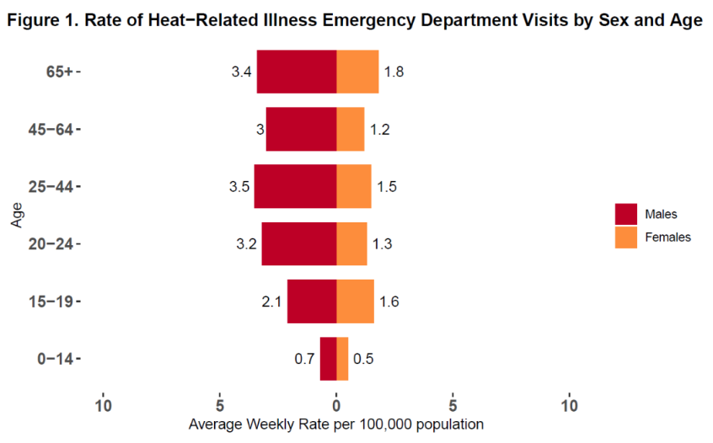
No So Fun Fact #3
Which NC age group has the highest number of emergency department visits for heat-related illnesses?
A. 0 – 14
B. 15 – 19
C. 20 – 24
D. 25 – 44
E. 45 – 64
F. 65+
Source: NC Statewide Annual Heat-related Illness Surveillance Report, May 1- September 30, 2024
NC Department of Health and Human Services, Climate and Health Team
Notes:
The other big risk we face in NC is that heat season overlaps with hurricane season.
Tropical Storm Chantal hit several communities in the central part of our state on July 6th. With 8 to 10 inches of rain falling in only 12 hours or so, the flooding was significant, especially in Alamance, Chatham, and Orange counties – all counties participating in our 2024-2025 Planning for Extreme Heat cohort. They reported that, following the storm was a lot of high heat during a time when residents needed to be outside to clean up after the storm.
We also worry about power outages.

Slide 14
Questions?
Andrea Webster
Resilience Policy Advisor State Resilience Office
andrea.webster@deq.nc.gov

